Slide 1

Bale/Doneen Live
Scientific Update Session
Amy Doneen DNP, ARNP
June 13, 2017
5:30-6:30 pm PST

Slide 2

Education
1. Paradigm Shift – Deployment of Preventive Interventions
Fire
2. Residual Inflammation post PCSK-9 and Statin Therapy
Roots
3. American Dental Guest Editorial
4. PD and Diabetes
5. BP – baseline values and SPRINT
6. BP differences predict stroke risk
7. CPAP and NT-ProBNP
8. Smoking and increased stroke risk
Optimal Goals
9. BNP affects mortality regardless of HF
Genetics
10. MyGenetx and Customer Appreciation
Treatment
11. NSAIDS effect on Celebrex, Naproxen, Ibuprophen
12 Supplements – JACC Review
13. Vit D and IR
14. Vit D – complexities
Agenda for June 2018
Scientific Update Session

Slide 3

What I can’t cover this month…so much information and such little time
Insulin resistance screening – 25 year assoc with renal and CV
Women post MI less likely to receive high intensity statins
Thyroid Review and CVD
PD and dyslipidemia
Stroke risk increased for 5 years post TIA
PPI use associated with CV Death
RAAS in Diabetics
Omega 3 review
Obesity pathophysiology and management
hsTnT and hsTnI to diagnose AMI
Gut Microbiome and arterial stiffness

Slide 4
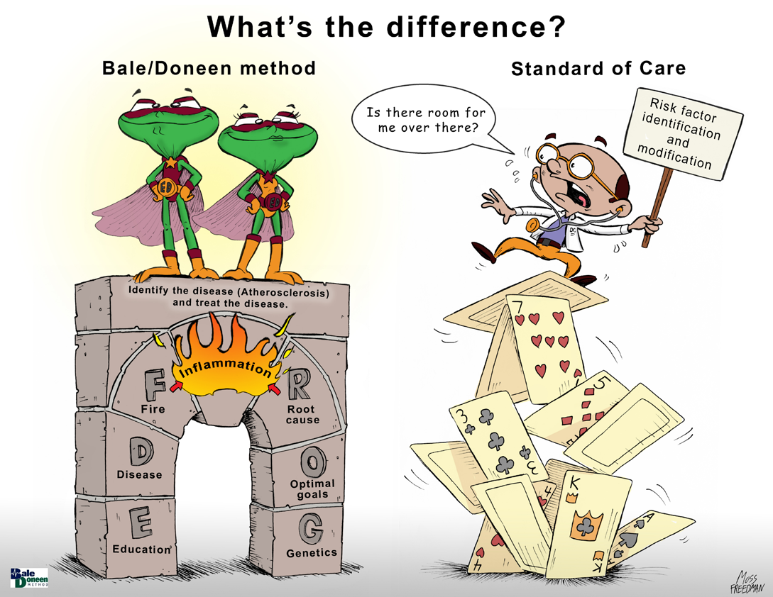

Too much can be destructive

Slide 5

The world may now be listening! Now is our time to share…

Slide 6
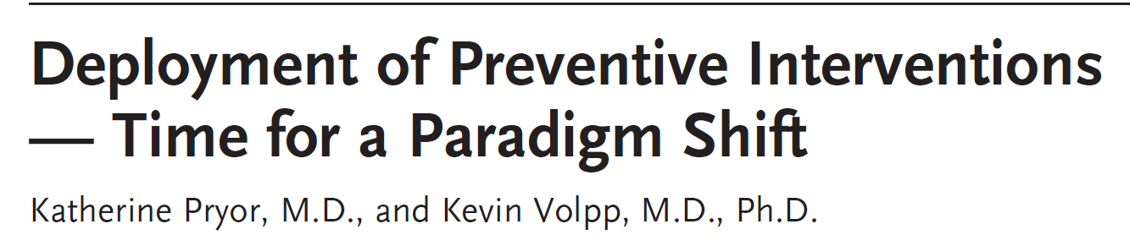
Why are highly effective preventative interventions adopted slowly if at all?
1. More resources directed to treatment rather than preventing disease – 2015 only 3% of healthcare dollars were spent on preventative services. However, accountable care organizations are now incentivizing for prevention.
2. Treatment determined by the FDA to be safe & effective are covered by insurers regardless of cost but preventative services are held to a higher standard – often assessed on the ROI and cost savings rather than long term benefit.
3. Insurance contracts usually 1 year long – insurers don’t want to spend money to prevent disease in members who will be covered by someone else in the future.
Pryor, K. and Volpp, K. (2018) Deployment of preventive interventions – time for a paradigm shift. N Engl J Med 378;19. May 10, 2018

Slide 7
Why are highly effective preventative interventions adopted slowly if at all?
4. Providers aren’t used to prescribing behavioral interventions – medications are heavily marketed and are viewed easier and more effective.
5. Many providers unaware of nonadherence of patients and don’t know what to do – prescribing a drug is viewed easier by the provider but not viewed that way by the patient. Cite – in year after MI, only 40-45% of patients take their meds as prescribed.
6. Concerns about scalability are often a barrier in the deployment of proven behavioral interventions.
Pryor, K. and Volpp, K. (2018) Deployment of preventive interventions – time for a paradigm shift. N Engl J Med 378;19. May 10, 2018

Slide 8

Pryor, K. and Volpp, K. (2018) Deployment of preventive interventions – time for a paradigm shift. N Engl J Med 378;19. May 10, 2018

Slide 9
Authors suggest – for health care’s transformation from a volume-to a value based framework to be successful:
1. Placing coverage for preventive services and treatments
2. Base benefits of preventive treatments based on benefits and risks rather than cost analysis
3. Change coverage for behavioral interventions
4. Incentivize payers and providers to reward health rather than illness.
5. Design ways to facilitate the uptake and deployment of preventive services on broader scale to achieve improved health at lower cost.
Pryor, K. and Volpp, K. (2018) Deployment of preventive interventions – time for a paradigm shift. N Engl J Med 378;19. May 10, 2018

Slide 10
BaleDoneen Take-Away:
The first step in EDFROG is EDUCATION!
Lifestyle is ALWAYS the most important intervention.
Showing prevention with the most costly healthcare issue – CVD/CAD – now that people are listening and asking for solutions – share YOUR results with all who will listen
Start with your patient population – share your results so you provide hope and demonstrate effectiveness.
BaleDoneen utilizes precision healthcare to optimize health and it take a community of providers!
Pryor, K. and Volpp, K. (2018) Deployment of preventive interventions – time for a paradigm shift. N Engl J Med 378;19. May 10, 2018

Slide 11
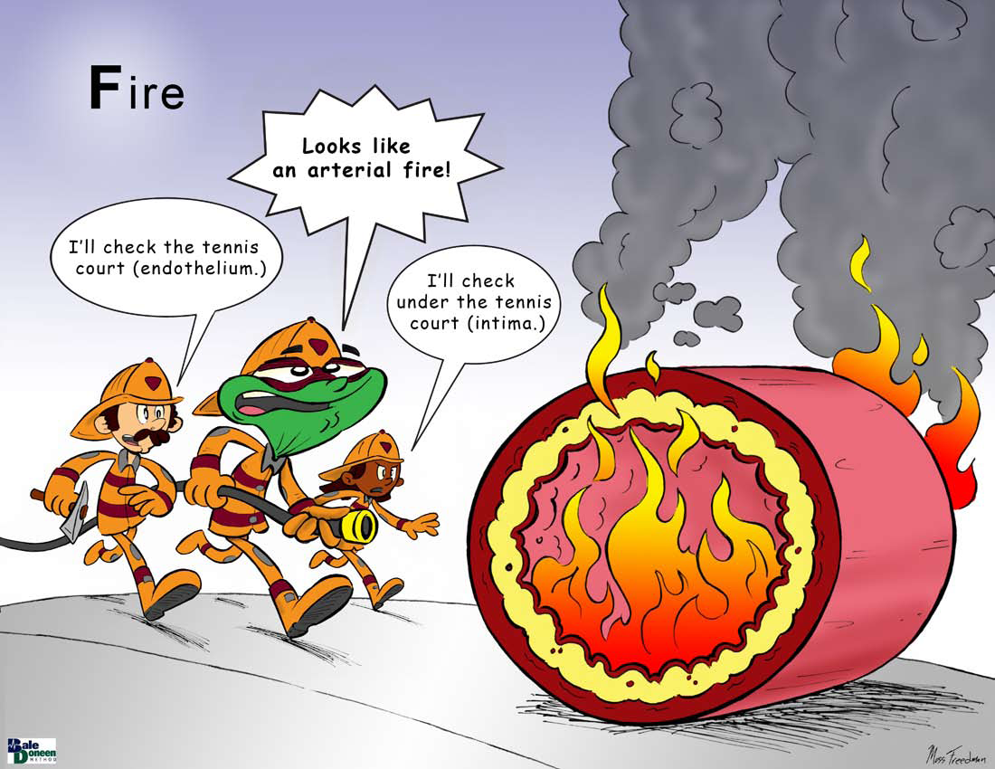

Slide 12
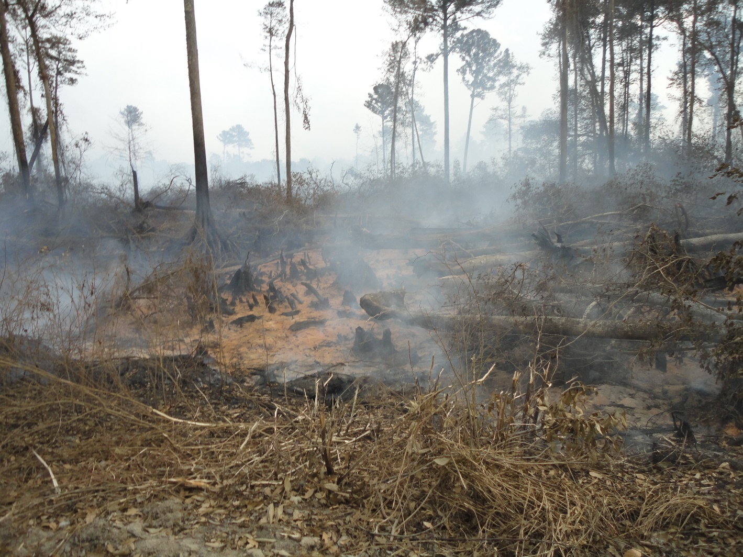
Residual inflammation – always be aware….

Slide 13
Residual inflammatory risk despite being on PCSK-9 and statin therapy.
Evaluated residual inflammatory risk among patients (n=9738) participating in the studies of PCSK9 Inhibition and the Reduction of Vascular Events (SPIRE)-1 and -2 CV outcomes trials who were receiving both statin therapy and bococizumab.
According to on-treatment levels of hsCRP (hsCRPOT) and LDL-COT measured 14 weeks after drug initiation.
The primary endpoint was:
nonfatal MI
nonfatal CVA
unstable angina
cardiovascular death
Pradhan, A., Aday, A., Rose, L, Ridker, P., (2018). Residual inflammatory risk in SPIRE outcomes trial. CIRCULATIONAHA.118.034645

Slide 14
Residual inflammatory risk despite being on PCSK-9 and statin therapy.
Recently, the Canakinumab (CANTOS) trial demonstrated that IL-1 inhibition with canakinumab significantly reduces both hsCRP and cardiovascular events in stable patients with prior myocardial infarction (MI) and elevated hsCRP with no change in LDL-C.
The magnitude of risk reduction in CANTOS was virtually identical to that achieved in the PCSK9 inhibitor trials of evolocumab and bococizumab (FOURIER and SPIRE) in stable high-risk populations.
Pradhan, A., Aday, A., Rose, L, Ridker, P., (2018). Residual inflammatory risk in SPIRE outcomes trial. CIRCULATIONAHA.118.034645

Slide 15
Residual inflammatory risk despite being on PCSK-9 and statin therapy.
Results—At 14 weeks, the mean percent change in combo group was:
LDL-C: -60.5% (95% CI -61.2 to -59.8; p<0.001; median change -65.4%) as compared to 6.6% (95% CI -1.0 to 14.1; p=0.09; median change 0.0%) for hsCRP.
Incidence rates for future CV events for combo patients according to:
hsCRP <1 mg/L: 1.96 events per 100 person years
hsCRP 1-3 mg/L: 2.50 events per 100 person years
hsCRP >3 mg/L: 3.59 events per 100 person years
Roughly 1 in 2 had residual inflammatory risk defined by on-tx hsCRP level >2 mg/L with roughly 1 in 3 having values > 3mg/L.
Pradhan, A., Aday, A., Rose, L, Ridker, P., (2018). Residual inflammatory risk in SPIRE outcomes trial. CIRCULATIONAHA.118.034645

Slide 16
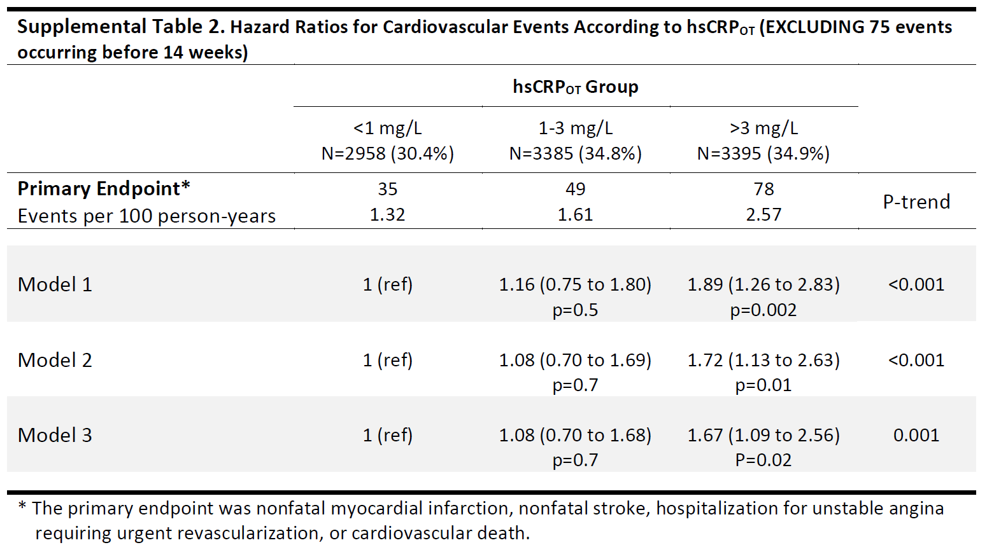
hsCRP results on PCSK9 and lipid therapy
Pradhan, A., Aday, A., Rose, L, Ridker, P., (2018). Residual inflammatory risk in SPIRE outcomes trial. CIRCULATIONAHA.118.034645

Slide 17
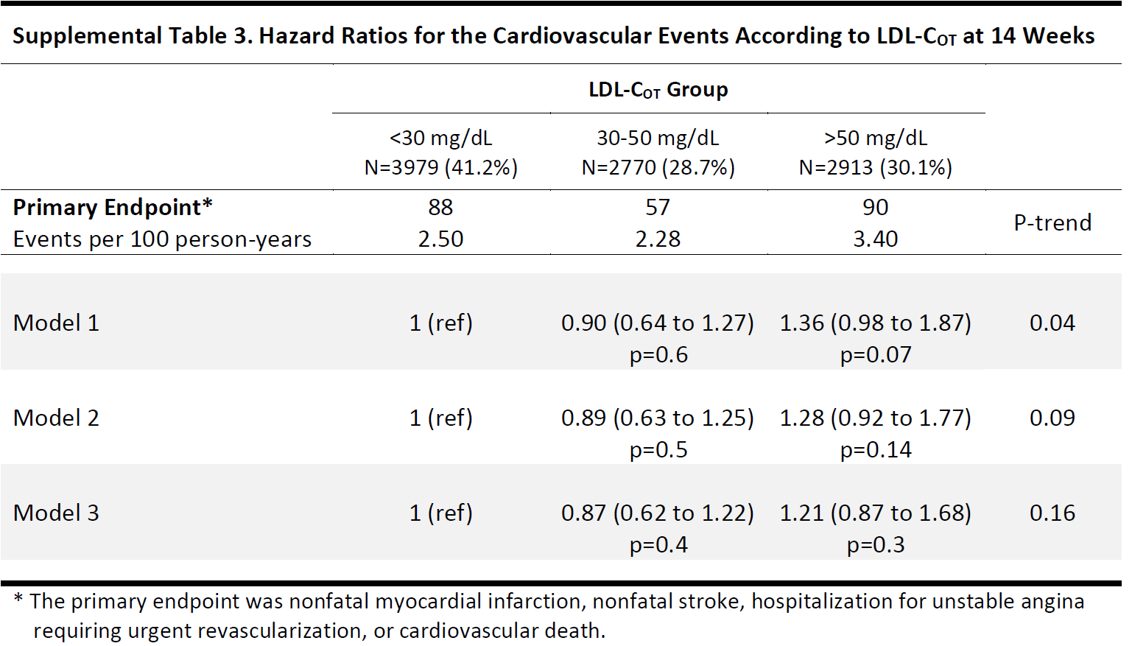
LDL-C results on PCSK9 and lipid therapy
Pradhan, A., Aday, A., Rose, L, Ridker, P., (2018). Residual inflammatory risk in SPIRE outcomes trial. CIRCULATIONAHA.118.034645

Slide 18
Residual inflammatory risk despite being on PCSK-9 and statin therapy.
In this post-hoc analysis of the SPIRE trials of bococizumab in a stable outpatient population, evidence of residual inflammatory risk persisted among patients treated with both statin therapy and PCSK9 inhibition.
Treatment with bococizumab was associated with a 60% mean reduction in LDL-C but little change in hsCRP.
Levels of hsCRP > 3 mg/L were associated with a 60% greater risk of future cardiovascular events corresponding to a 3.6% annual event rate (3.6 per 100 person-years) even after accounting for on-treatment LDL-C.
Pradhan, A., Aday, A., Rose, L, Ridker, P., (2018). Residual inflammatory risk in SPIRE outcomes trial. CIRCULATIONAHA.118.034645

Slide 19
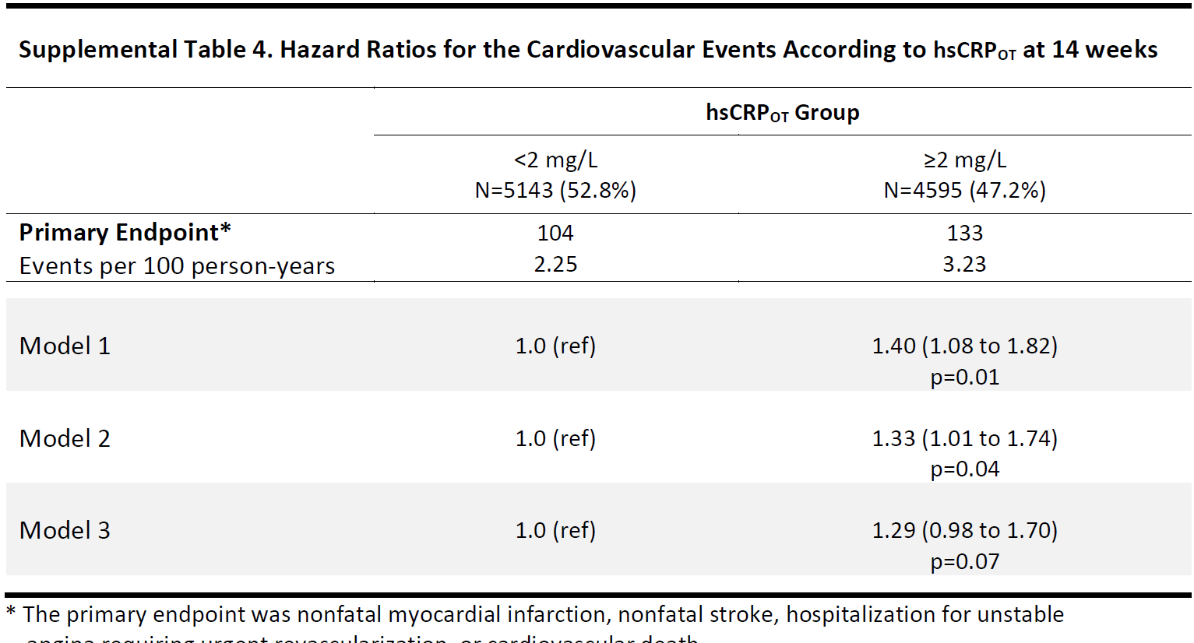
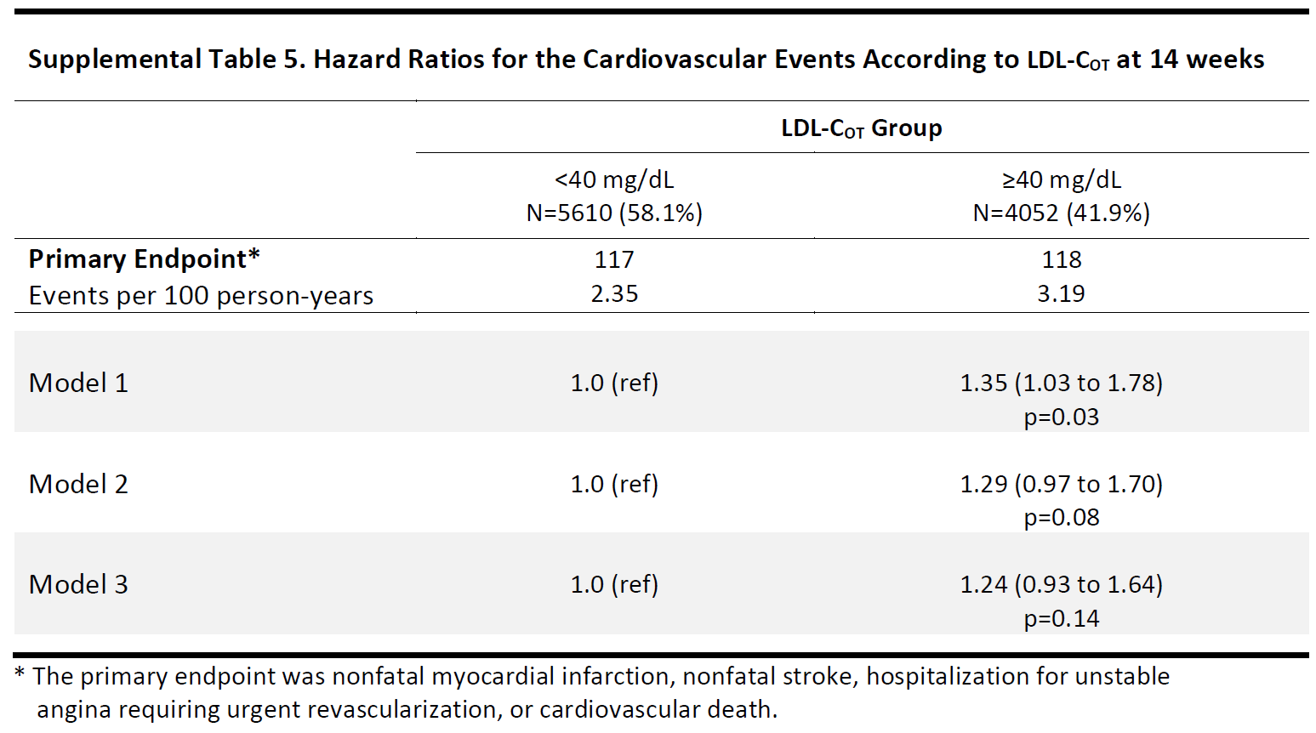
CV events based on hsCRP levels & LDL-C levels at 14 wks
Pradhan, A., Aday, A., Rose, L, Ridker, P., (2018). Residual inflammatory risk in SPIRE outcomes trial. CIRCULATIONAHA.118.034645
Notes:
Model 1: age and sex-adjusted
Model 2: additionally adjusted for baseline smoking, diabetes, hypertension, BMI, baseline statin (moderate or high intensity
Model 3: additionally adjusted for on-treatment hsCRP
All models stratified by study (SPIRE-1 or SPIRE-2), region, and screening LDL-C

Slide 20
Residual inflammatory risk despite being on PCSK-9 and statin therapy.
Individuals with persistent hsCRP elevation had multiple risk factors including diabetes, obesity, hypertension, and mixed dyslipidemia, conditions known to correlate with a pro-inflammatory state.
PCSK9 inhibition had no effect on hsCRP over time.
Despite aggressive reduction of LDL-C, there was a continuous gradient in risk for future cardiovascular events according to on-treatment hsCRP.
Compared to those without evidence of subclinical inflammation, those with on-treatment hsCRP > 3 mg/L (median on-treatment LDL-C 41.7 mg/dl) had a 62% increase in risk of future cardiovascular events.
Elevated hsCRP was significantly associated with increased rates of non-fatal MI, cardiovascular death, and all-cause mortality
Pradhan, A., Aday, A., Rose, L, Ridker, P., (2018). Residual inflammatory risk in SPIRE outcomes trial. CIRCULATIONAHA.118.034645

Slide 21

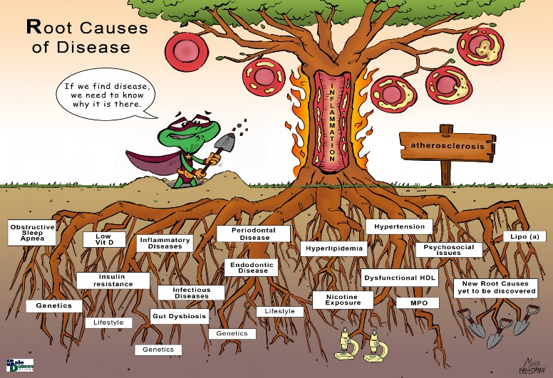
Residual inflammatory risk despite being on PCSK-9 and statin therapy.
BaleDoneen Take-Away:
Inflammation is causal!
Assess for all the root causes.
Despite pushing LDL to minimal levels – monitor inflammation to determine if patient is stable/safe.
Remember the root cause tree….
Pradhan, A., Aday, A., Rose, L, Ridker, P., (2018). Residual inflammatory risk in SPIRE outcomes trial. CIRCULATIONAHA.118.034645

Slide 22
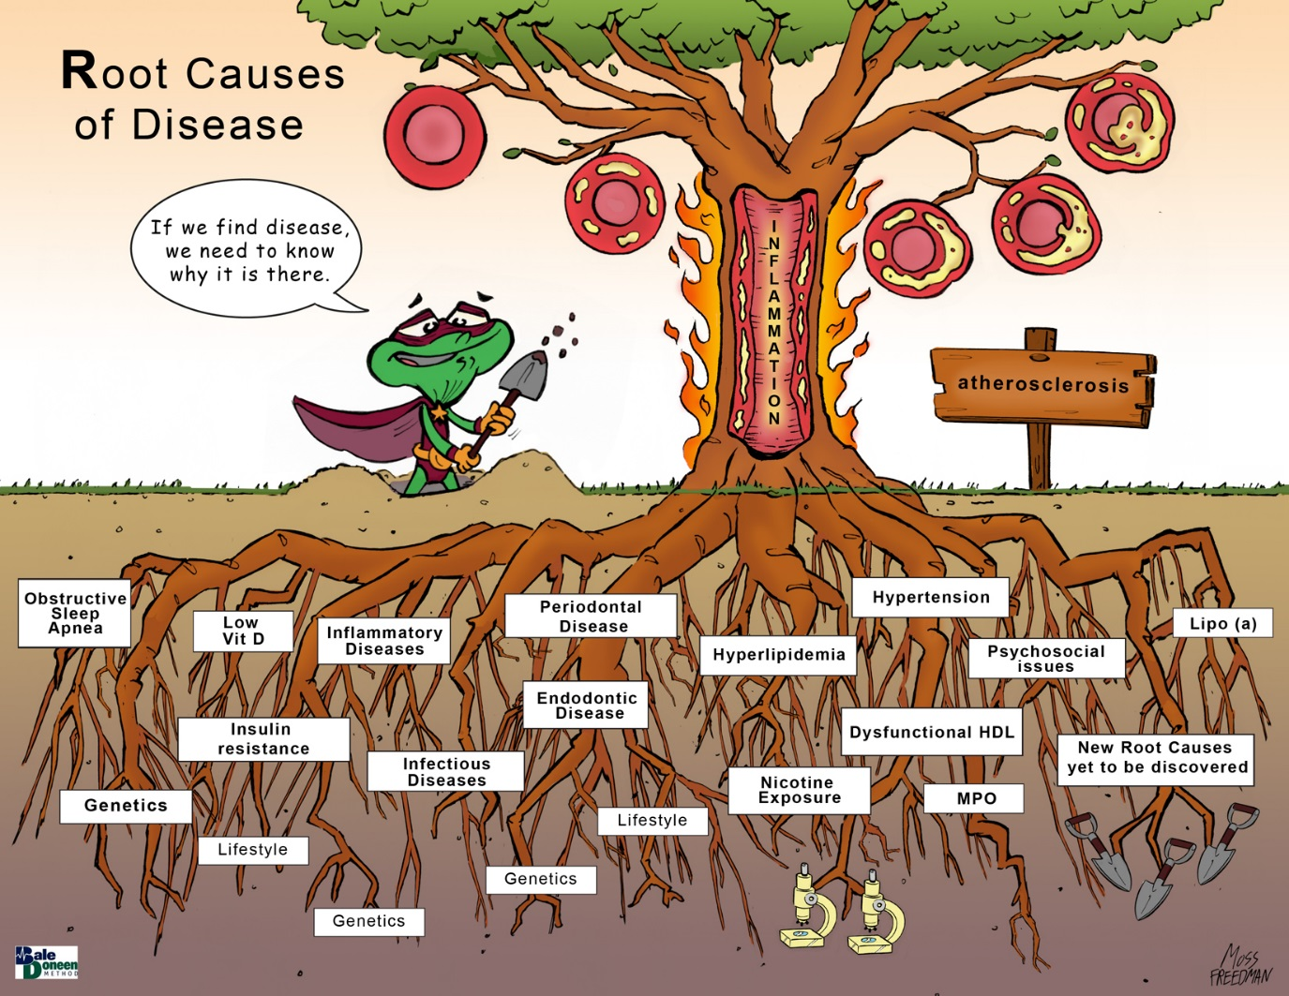
Nicotine
Endodontic Disease
Periodontal Disease
Gut dysbiosis

Slide 23


Pihlstrom, B., Hodges, J., Michalowicz et al. (June 1,2018). Promoting oral health care because of its possible effect on systemic disease is premature and may be misleading. J.adaj.2018.03.030.

Slide 24
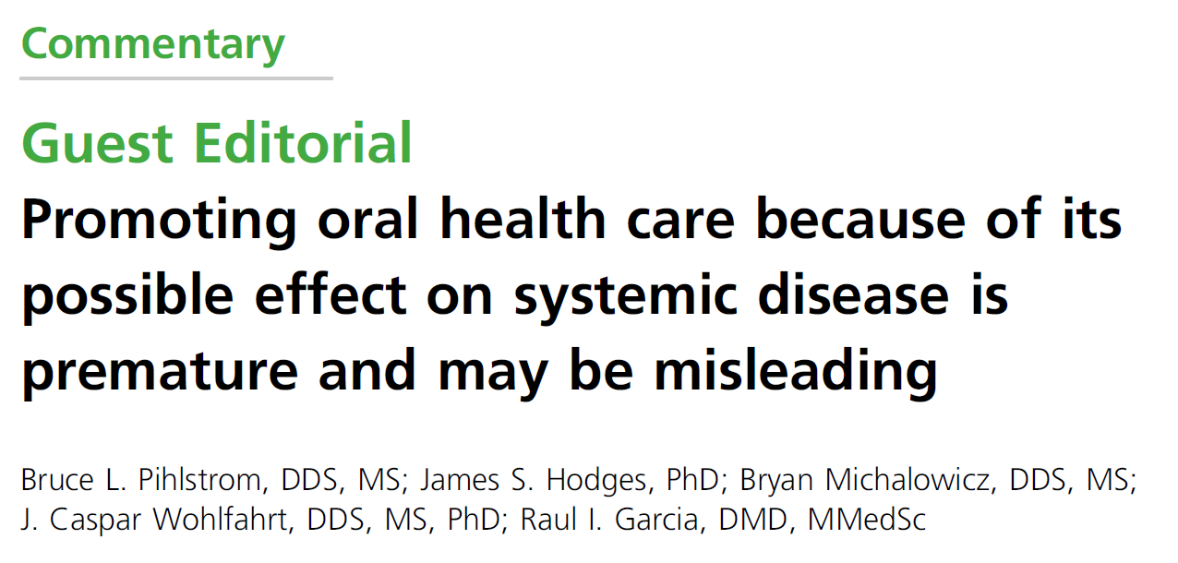
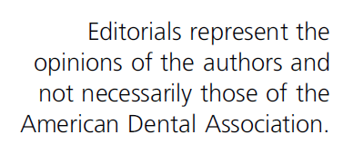
Pihlstrom, B., Hodges, J., Michalowicz et al. (June 1,2018). Promoting oral health care because of its possible effect on systemic disease is premature and may be misleading. J.adaj.2018.03.030.

Slide 25
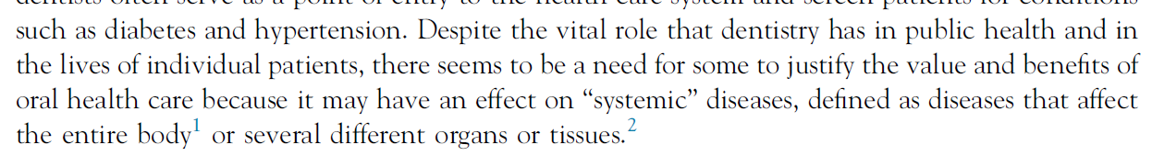
“Despite the vital role that dentistry has in public health and in the lives of individual patients, there seems to be a need for some to justify the value and benefits of oral health care because it may have an effect on “systemic” diseases”.
Pihlstrom, B., Hodges, J., Michalowicz et al. (June 1,2018). Promoting oral health care because of its possible effect on systemic disease is premature and may be misleading. J.adaj.2018.03.030.

Slide 26
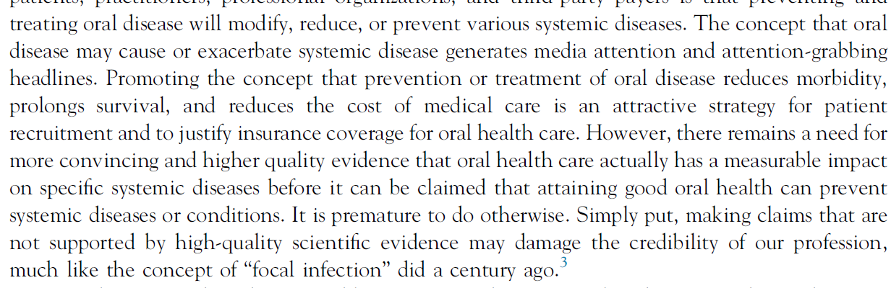
“The concept that oral disease may cause or exacerbate systemic disease generates media attention and attention-grabbing headlines.”
“There remains a need for more convincing and higher quality evidence”
“it is premature and may damage the credibility of our profession”
Pihlstrom, B., Hodges, J., Michalowicz et al. (June 1,2018). Promoting oral health care because of its possible effect on systemic disease is premature and may be misleading. J.adaj.2018.03.030.

Slide 27
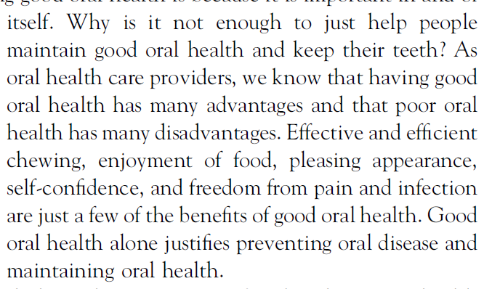
“Why is it not enough to just help people maintain good oral health and keep their teeth?”
“Good oral health has many advantages – effective and efficient chewing, enjoyment of food, pleasing appearance, self-confidence, and freedom from pain and infection”
“Good oral health alone justifies preventing oral disease and maintaining oral health.”
Pihlstrom, B., Hodges, J., Michalowicz et al. (June 1,2018). Promoting oral health care because of its possible effect on systemic disease is premature and may be misleading. J.adaj.2018.03.030.

Slide 28

When asked about my response to this article – this is what I said
“Any response to the ADA on behalf of AAOSH, needs to be grounded firmly in science rather than anecdotal opinion statements – it is the only way to make a paradigm change”
To once again quote my favorite author, Dr. Maya Angelou – “Do the best you can until you know better then, when you know better, simply do better.” Well my friends…..it is time WE do better!
Pihlstrom, B., Hodges, J., Michalowicz et al. (June 1,2018). Promoting oral health care because of its possible effect on systemic disease is premature and may be misleading. J.adaj.2018.03.030.

Slide 29
Bale, B. F., Doneen, A. L., & Vigerust, D. J. (2017). High-risk periodontal pathogens contribute to the pathogenesis of atherosclerosis. Postgraduate Medical Journal, 93(1098), 215-220.

Slide 30
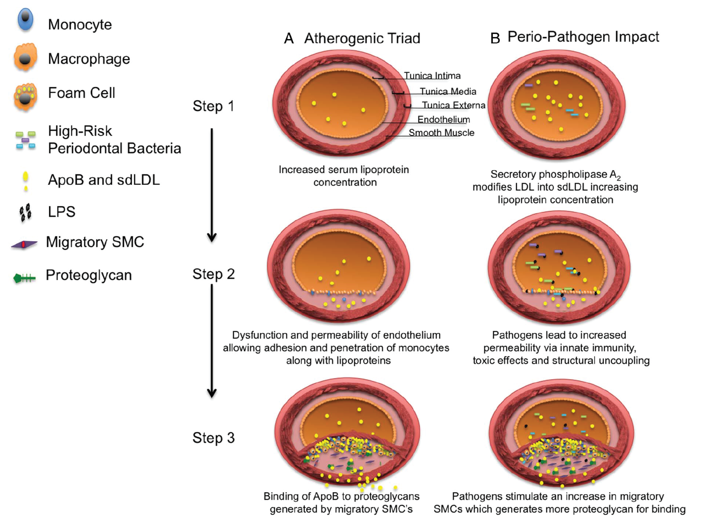
Bale, B. F., Doneen, A. L., & Vigerust, D. J. (2016). High-risk periodontal pathogens contribute to the pathogenesis of atherosclerosis. Postgraduate Medical Journal. doi:10.1136/postgradmedj-2016-134279

Slide 31
High-risk Periodontal Pathogens Contribute to the Pathogenesis of Atherosclerosis
Periodontal disease (PD) caused by high-risk pathogens can adversely inﬂuence all elements of the atherogenic triad.
Therefore, this type of PD can be considered a contributory cause of arterial disease.
Bale, B. F., Doneen, A. L., & Vigerust, D. J. (2016). High-risk periodontal pathogens contribute to the pathogenesis of atherosclerosis. Postgraduate Medical Journal. doi:10.1136/postgradmedj-2016-134279

Slide 32
High-risk Periodontal Pathogens Contribute to the Pathogenesis of Atherosclerosis
The dental community has a substantial opportunity to mitigate the number one cause of morbidity and mortality, namely CVD, by elucidating feasible effective management of PD due to high-risk pathogens.
Bale, B. F., Doneen, A. L., & Vigerust, D. J. (2016). High-risk periodontal pathogens contribute to the pathogenesis of atherosclerosis. Postgraduate Medical Journal. doi:10.1136/postgradmedj-2016-134279

Slide 33
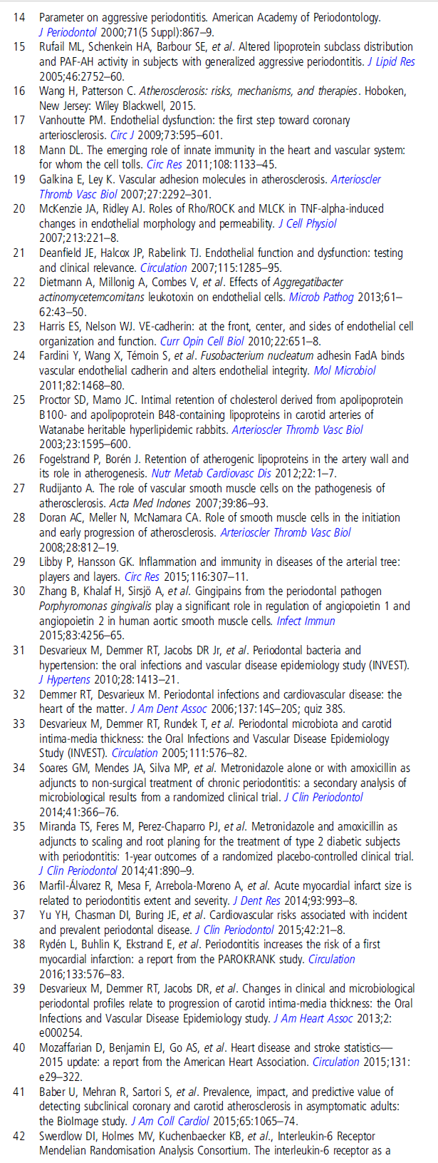
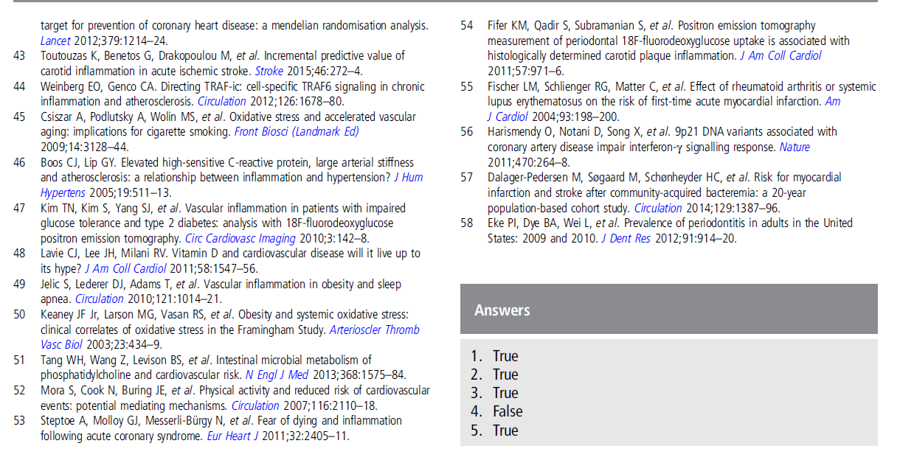
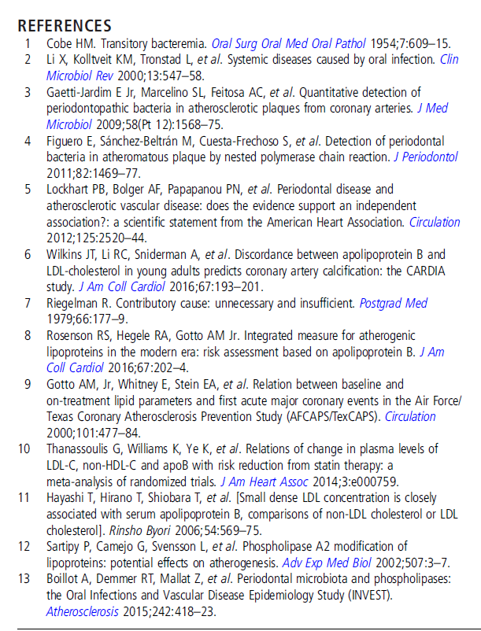
Reference list for high risk PD pathogen and causality paper

Slide 34
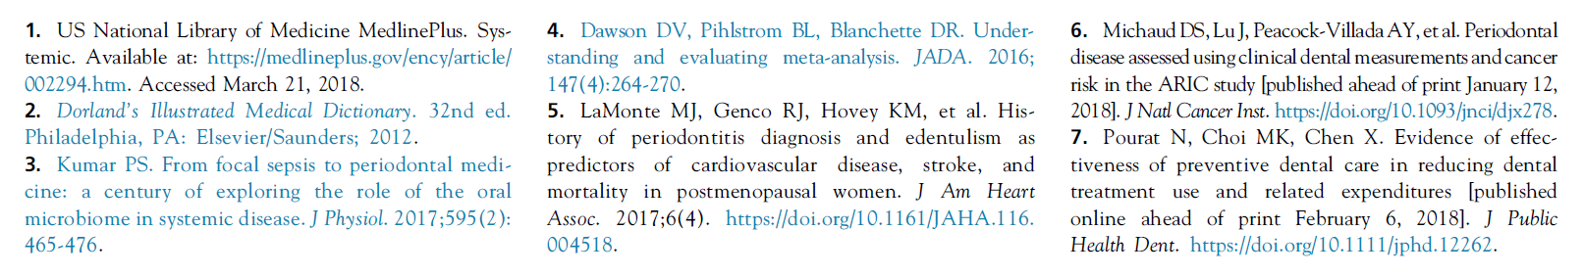
Reference list for ADA guest editorial piece -
Pihlstrom et al:
“Good oral health has many advantages – effective and efficient chewing, enjoyment of food, pleasing appearance, self-confidence, and freedom from pain and infection”
“Good oral health alone justifies preventing oral disease and maintaining oral health.”
“There remains a need for more convincing and higher quality evidence”

Slide 35
So let’s examine what was published in last few days -
Last month Sen et al – PD and CVA
Today – let’s discuss new data discussing periodontal disease treatment and improvement in T2DM patients.

Slide 36
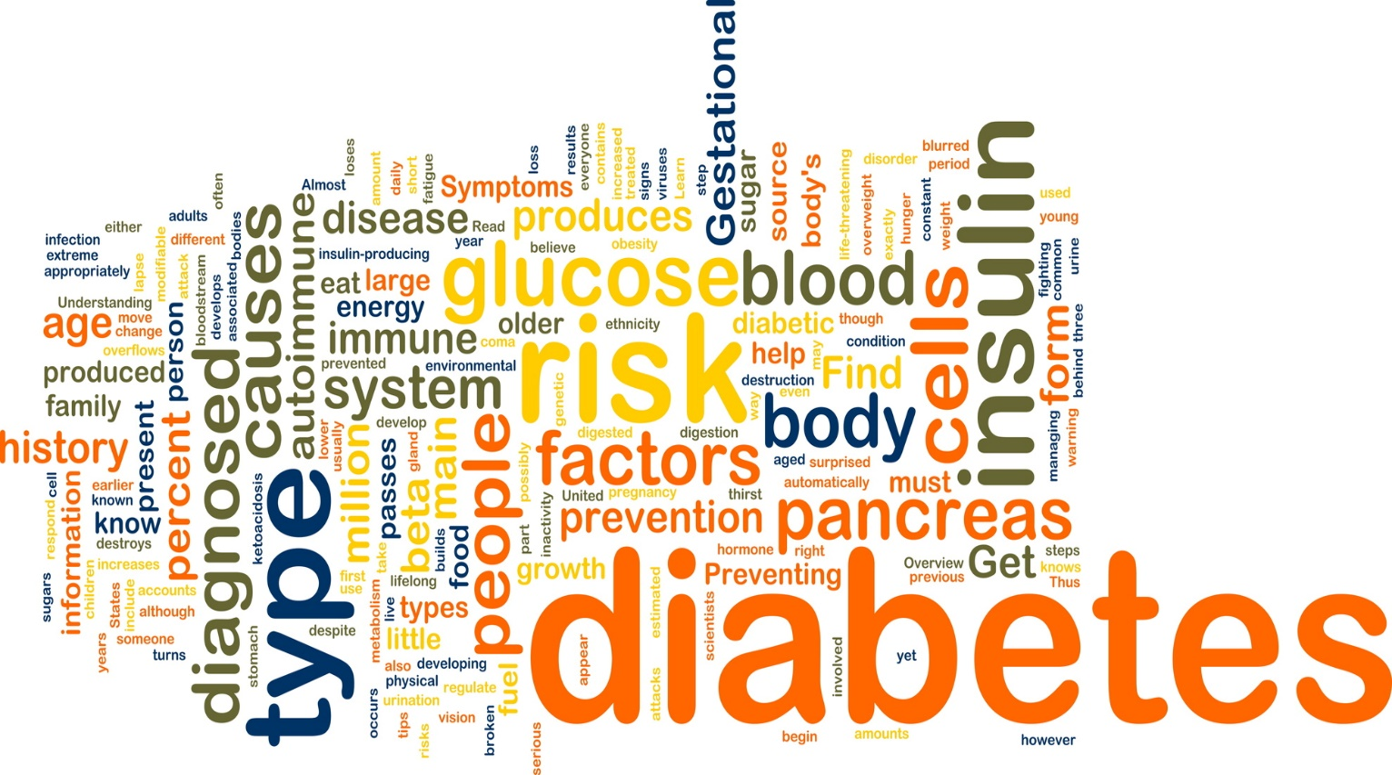
PD treatment and DM

Slide 37
PD tx in T2DM with chronic PD
Objective: To evaluate the effect of non-surgical periodontal treatment on serum HbA1c levels in patients with T2DM
Research Design and Methods: 6-month, single-masked, randomized clinical trial based on 90 patients (HbA1c: 7.7% (61 mmol/mol) ± 1.13%) randomly assigned to either:
1. Treatment group oral hygiene instructions + scaling and root planing using ultrasound and Gracey curettes
2. Control group oral hygiene instructions + supragingival removal of plaque and calculus using ultrasound
Pocket depth, gingival index, and plaque index were assessed at baseline and after 3 and 6 months together with determinations of fasting plasma glucose, HbA1c, and bacterial counts.
Mauri-Obradors, E., Merlos, A., Estrugo-Devesa, A. et al. (2018). Benefits of non-surgical periodontal treatment in patients with type 2 DM and chronic periodontitis: A randomized controlled trial. J Clin Periodontol. 2018;1-9.
Notes:
All study participants were instructed in oral hygiene using the
modified Bass technique. Periodontal 4 was performed at baseline
by removal supragingival deposits (plaque and calculus) using an ultrasonic
scaler (Satelec P5 Newtron XS, Acteon, Merignac, France).
In addition, TG patients were treated by full-mouth
debridement, which consisted of scaling and root planing (SRP). Loss of periodontal
health defined as a PPD >2 mm and periodontal attachment loss
of >2 mm in >30% of the evaluated sites were considered as criteria
of withdrawing from CG, none of patients satisfy these criteria.
Control visits were conducted at 3 and 6 months, HbA1c value was
recorded at baseline and at 6-month
visit, oral hygiene instructions
were repeated, and mouth debridement was conducted for individuals
in the TG when needed (presence of points of bleeding and/or
increased PPD).

Slide 38
PD tx in T2DM with chronic PD
Results: Treatment significantly improved the periodontal and metabolic parameters (p < .05), whereas in the control group no improvement was observed.
These results were consistent with the bacteriological results in most but not all cases.
Conclusion: Non-surgical periodontal treatment resulted in a better glycemic status of type 2 diabetes patients and demonstrated the importance of oral health in their general health.
Mauri-Obradors, E., Merlos, A., Estrugo-Devesa, A. et al. (2018). Benefits of non-surgical periodontal treatment in patients with type 2 DM and chronic periodontitis: A randomized controlled trial. J Clin Periodontol. 2018;1-9.

Slide 39
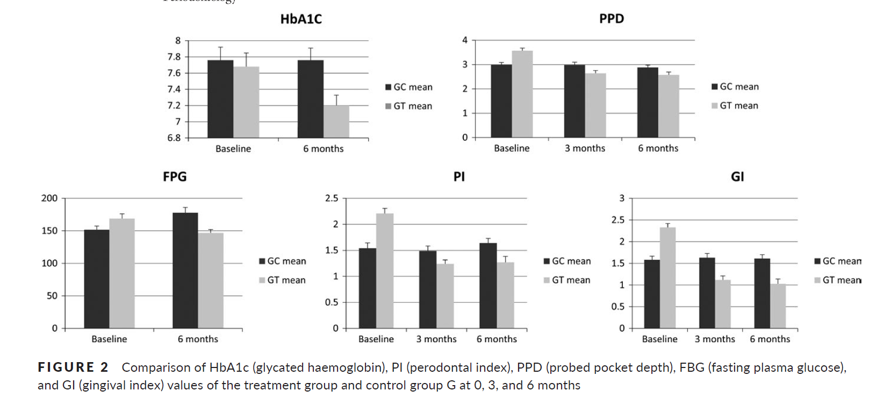
PD tx in T2DM with chronic PD
Control
Treatment
Mauri-Obradors, E., Merlos, A., Estrugo-Devesa, A. et al. (2018). Benefits of non-surgical periodontal treatment in patients with type 2 DM and chronic periodontitis: A randomized controlled trial. J Clin Periodontol. 2018;1-9.

Slide 40
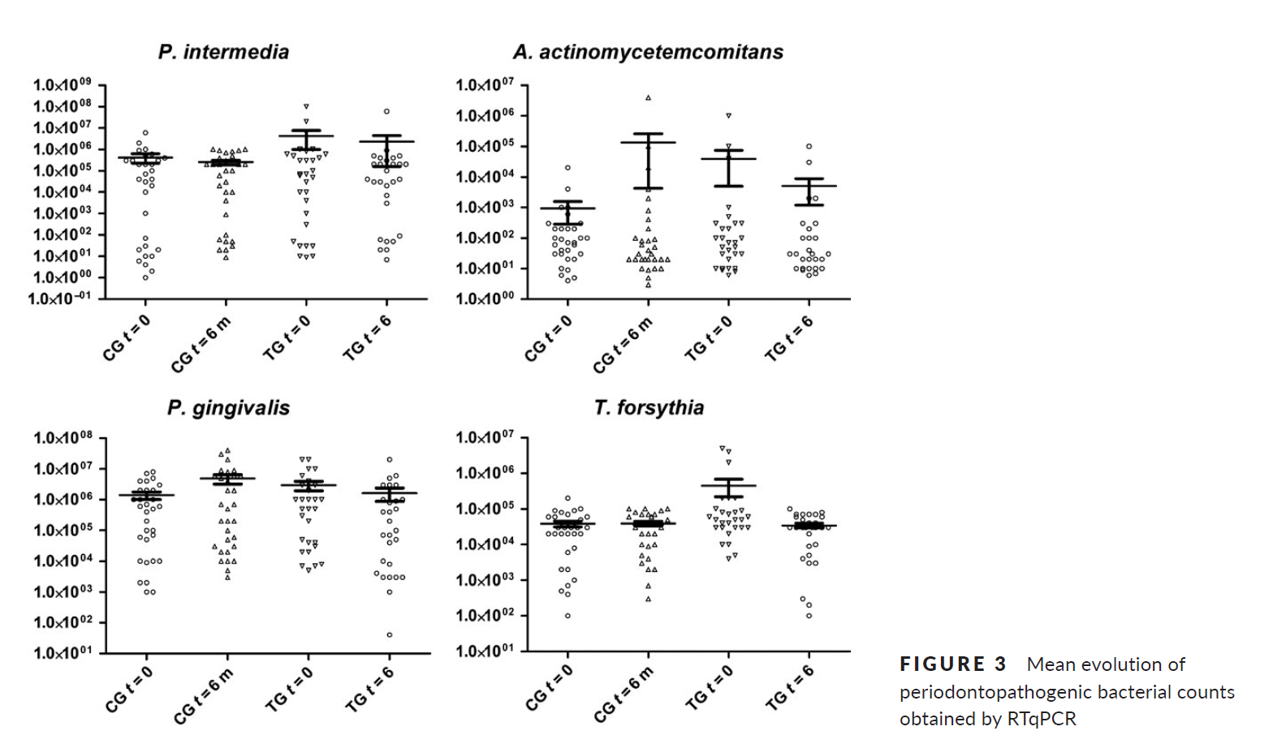
PD tx in T2DM with chronic PD
Mauri-Obradors, E., Merlos, A., Estrugo-Devesa, A. et al. (2018). Benefits of non-surgical periodontal treatment in patients with type 2 DM and chronic periodontitis: A randomized controlled trial. J Clin Periodontol. 2018;1-9.

Slide 41
PD tx in T2DM with chronic PD
To explore whether 6 months of non-surgical periodontal therapy can lead to a reduction in HbA1c levels in patients with type 2 diabetes having generalized chronic periodontitis by means of a randomized clinical trial.
Non-surgical periodontal treatment during 6 months is associated with significant improvement in metabolic control. Bacteriological analysis of periodontal microbiota by PCR showed poor association.
Aggregatibacter actinomycetemcomitans (Aa) Porphyromonas gingivalis (Pg), and Tannerella forsythia (Tf)
Mauri-Obradors, E., Merlos, A., Estrugo-Devesa, A. et al. (2018). Benefits of non-surgical periodontal treatment in patients with type 2 DM and chronic periodontitis: A randomized controlled trial. J Clin Periodontol. 2018;1-9.

Slide 42
PD tx in T2DM with chronic PD
BaleDoneen Take-Away:
This is yet another study that continues to yield data to support the oral/systemic connection.
Our stance is that the data is strong and robust enough to support the relationship between high risk periodontal pathogens and the atherogenic triad.
Looking at the relationship of PD in other systemic disease states continues to propel the association.
Unlike the position taken by the guest editorial in JADA, we believe completely that the high risk oral pathogens ARE just as important as all of the other root causes of vascular inflammation.
Mauri-Obradors, E., Merlos, A., Estrugo-Devesa, A. et al. (2018). Benefits of non-surgical periodontal treatment in patients with type 2 DM and chronic periodontitis: A randomized controlled trial. J Clin Periodontol. 2018;1-9.

Slide 43
Nicotine
Endodontic Disease
Hypertension
Gut dysbiosis

Slide 44
Blood Pressure Goal of < 120 mm Hg Reduces CV Risk in High Risk Adults
9,361 pts.; >50 yo; syst BP > 130 mm Hg; plus at least one additional risk factor- (known CVD; > 75 yo; > stage 3 CKD; FRS >15%
Randomized to systolic goal of < 140 mm Hg or < 120 mm Hg
National Institutes of Health (NIH) - Turning Discovery Into Health – news release 9/11/2015. Landmark NIH study shows intensive blood pressure management may save lives.
Notes:
100 medical centers and clinical practices throughout the United States and Puerto Rico. It is the largest study of its kind to date to examine how maintaining systolic blood pressure at a lower than currently recommended level will impact cardiovascular and kidney diseases. NIH stopped the blood pressure intervention earlier than originally planned in order to quickly disseminate the significant preliminary results. The study population was diverse and included women, racial/ethnic minorities, and the elderly.
28% had CKD; excluded resistive hypertension (i.e. BP 180 mm Hg on therapy), type 2 DM (studied in ACCORD), post stroke pts.
Investigator Cushman (Prof. Preventive Med at U of TN) stated the SPRINT population was twice the size of ACCORD and the pts were higher risk in SPRINT; that is why he thinks ACCORD showed only a NS 12% decrease in CV outcomes (40% signif. Stroke reduction though).

Slide 45
Blood Pressure Goal of < 120 mm Hg Reduces CV Risk in High Risk Adults
Achieved BP in < 140 mm Hg arm averaged ~ 134 mm Hg and took ~ 2 meds.
Achieved BP in < 120 mm Hg arm averaged ~ 119 mm Hg and took ~ 3 meds.
National Institutes of Health (NIH) - Turning Discovery Into Health – news release 9/11/2015. Landmark NIH study shows intensive blood pressure management may save lives.
Notes:
28% had CKD; excluded resistive hypertension (i.e. BP 180 mm Hg on therapy), type 2 DM (studied in ACCORD), post stroke pts.
Investigator Cushman (Prof. Preventive Med at U of TN) stated the SPRINT population was twice the size of ACCORD and the pts were higher risk in SPRINT; that is why he thinks ACCORD showed only a NS 12% decrease in CV outcomes (40% signif. Stroke reduction though).

Slide 46
Blood Pressure Goal of < 120 mm Hg Reduces CV Risk in High Risk Adults
Trial stopped 6 months early due to a significant 33% reduction in primary CV outcomes and a significant 25% reduction in all-cause mortality in the intensive treatment group.
National Institutes of Health (NIH) - Turning Discovery Into Health – news release 9/11/2015. Landmark NIH study shows intensive blood pressure management may save lives.
Notes:
28% had CKD; excluded resistive hypertension (i.e. BP 180 mm Hg on therapy), type 2 DM (studied in ACCORD), post stroke pts.
Investigator Cushman (Prof. Preventive Med at U of TN) stated the SPRINT population was twice the size of ACCORD and the pts were higher risk in SPRINT; that is why he thinks ACCORD showed only a NS 12% decrease in CV outcomes (40% signif. Stroke reduction though).

Slide 47
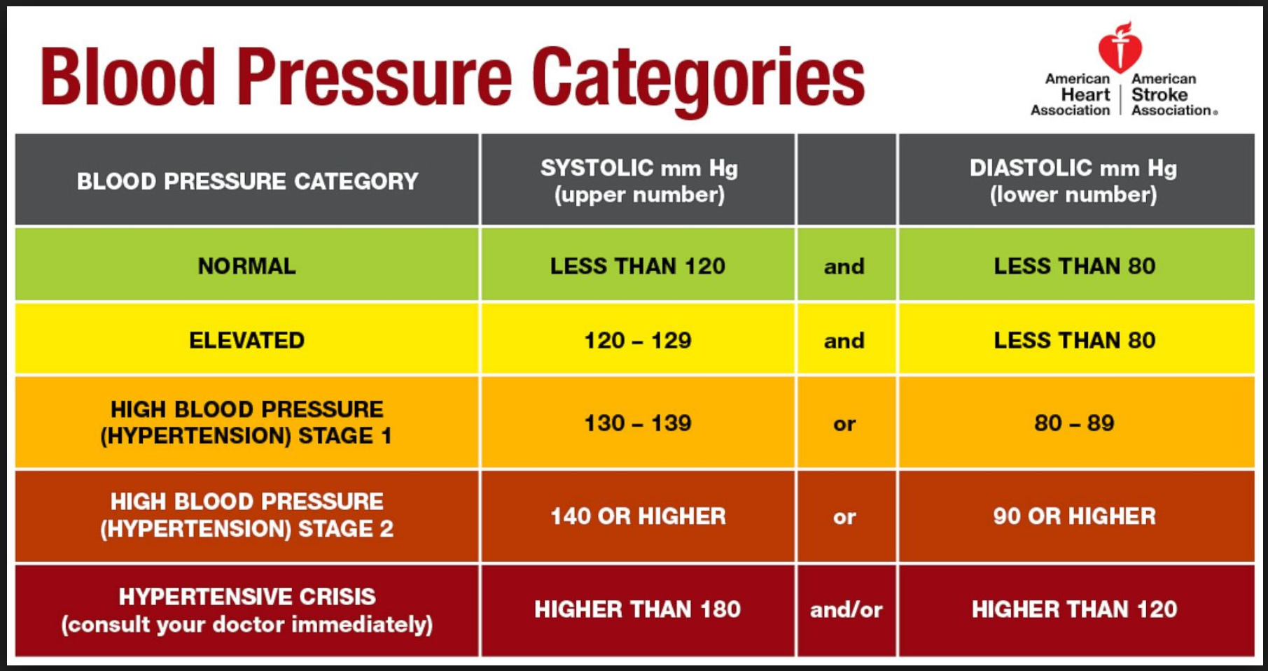
November 2017

Slide 48
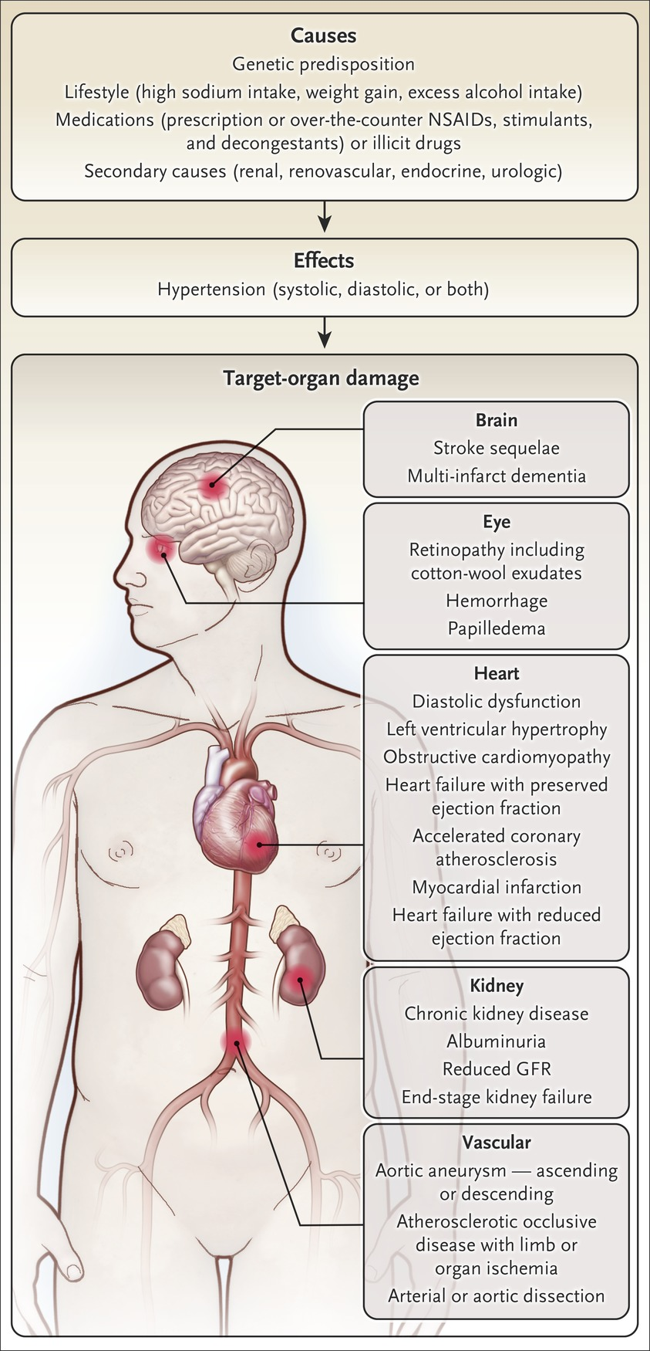
Initial Treatment of Hypertension
Why identify and treat hypertension early?
Stroke
Dementia
Retinopathy
Retinal hemorrhage
Papilledema
Diastolic dysfunction
Left ventricular hypertrophy
Obstructive cardiomyopathy
Heart Failure with preserved EF
Accelerated coronary atherosclerosis
Heart Failure with reduced EF
Chronic Kidney Disease
Albuminuria
Reduced GFR
End-stage Kidney Disease
Aortic aneurysm – ascending or descending
Limb or organ ischemia
Arterial or aortic dissection
Taler SJ. N Engl J Med 2018;378:636-644

Slide 49
Impact of Intensive Versus Standard BP Management by Tertiles of BP in the SPRINT trial.
The purpose of the present report was to expand on the previously reported findings by providing a more detailed analysis of treatment differences and primary outcome component event rates by baseline SBP tertiles.
Researchers examined, by tertile, baseline characteristics and risk factors, outcomes, adverse events, differences in utilization of CVD guideline-based medications, and BP at baseline and follow-up among the SBP tertile groups
Shapiro, B., Ambrosius, W., Blackshear, J. et al. (2018). Impact on intensive versus standard BP Management by tertiles of BP in SPRINT. Hypertension;71(6):1064-1074.

Slide 50
Impact of Intensive Versus Standard BP Management by Tertiles of BP in the SPRINT trial.
Why does this matter?
Data from the NHAINES Survey suggest that 16.8 million US adults (7.6%) would fulfill the SPRINT eligibility criteria and thus potentially benefit from intensive BP control.
Whether the findings of SPRINT may be generalizable to other patient populations is unknown.
Shapiro, B., Ambrosius, W., Blackshear, J. et al. (2018). Impact on intensive versus standard BP Management by tertiles of BP in SPRINT. Hypertension;71(6):1064-1074.

Slide 51
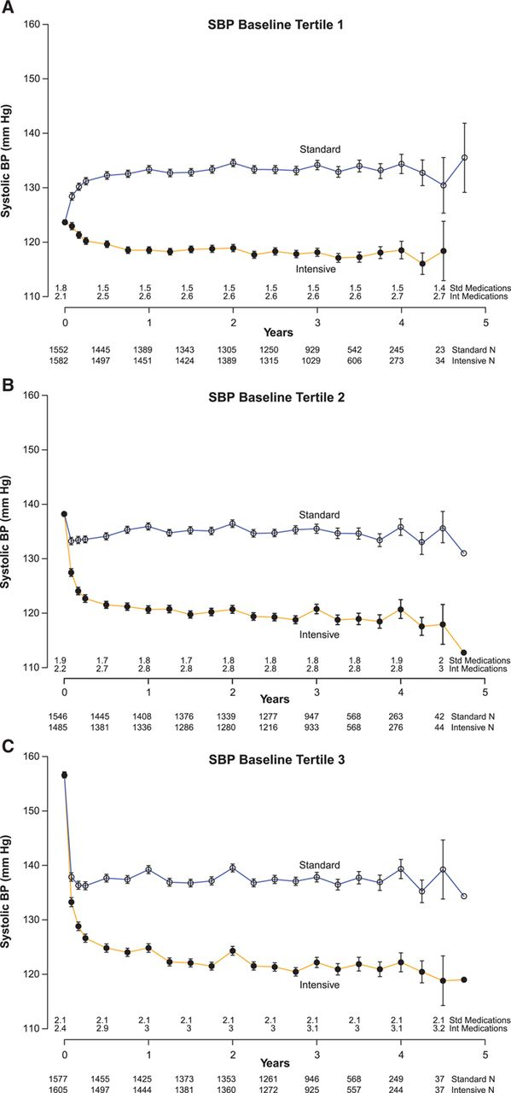
Impact of Intensive Versus Standard BP Management by Tertiles of BP in the SPRINT trial.
Systolic blood pressure by baseline tertile:
(A) SBP <132 mm Hg
(B) SBP 132-145 mmHg (C), SBP >145 mm Hg
Participants with higher baseline SBP tertile were more often women and older, had higher CV risk, and lower utilization of antihypertensives, statins, and ASA
Shapiro, B., Ambrosius, W., Blackshear, J. et al. (2018). Impact on intensive versus standard BP Management by tertiles of BP in SPRINT. Hypertension;71(6):1064-1074.

Slide 52
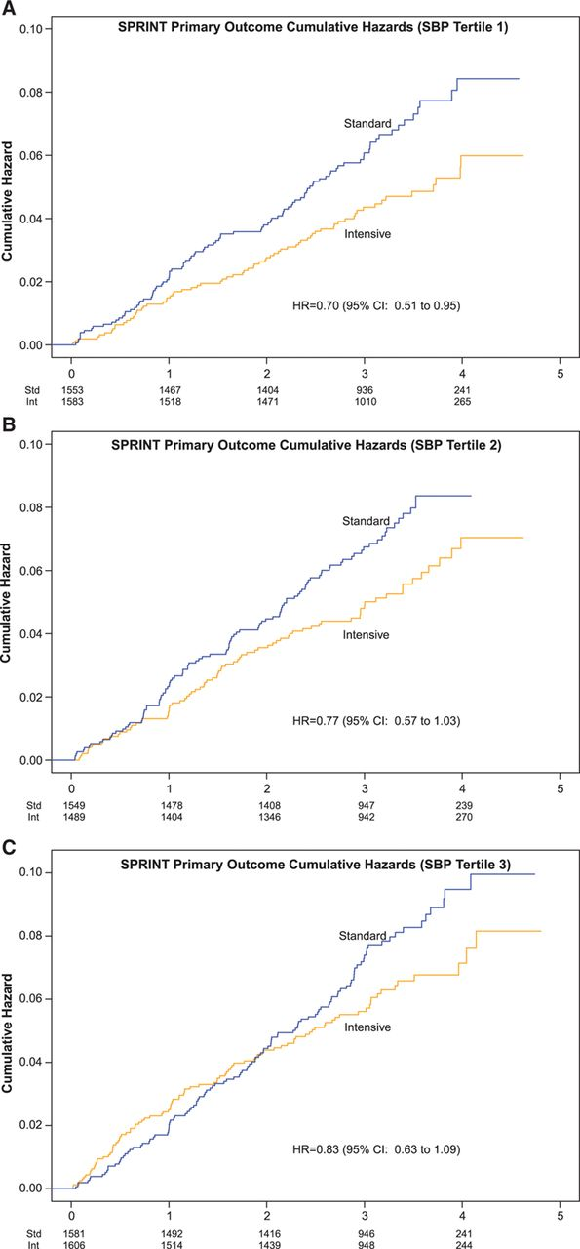
Impact of Intensive Versus Standard BP Management by Tertiles of BP in the SPRINT trial.
Medication utilization differed
across the SBP tertiles at baseline with a lesser percentage of diuretics and ACE/ARB drugs in the higher tertiles - a finding that reversed during the trial.
The beneficial effects
of intensive SBP lowering were not modified by the level of baseline SBP.
These findings add support for clinicians to treat blood pressure to goal irrespective of baseline SBP.
Shapiro, B., Ambrosius, W., Blackshear, J. et al. (2018). Impact on intensive versus standard BP Management by tertiles of BP in SPRINT. Hypertension;71(6):1064-1074.

Slide 53
Impact of Intensive Versus Standard BP Management by Tertiles of BP in the SPRINT trial.
BaleDoneen Take Away:
1. Optimal SBP management was important regardless of baseline BP levels.
2. Treat ALL patients (especially those who are at risk for an event) to optimal SBP levels.
3. The benefit of SBP attainment outweighed the risk of multiple medication application.
4. Sadly, some of the most vulnerable patients in the highest tertile of SBP at baseline, were on less protective medications.
5. EDFROG all patients!
Shapiro, B., Ambrosius, W., Blackshear, J. et al. (2018). Impact on intensive versus standard BP Management by tertiles of BP in SPRINT. Hypertension;71(6):1064-1074.

Slide 54
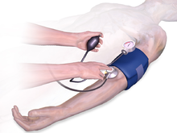
Simultaneously Measured Interarm Blood Pressure
Difference and Stroke
Tomiyama, Hl, Ohkuma, T., Ninomiya, T. et al. (2018). Simultaneously measured interarm blood pressure difference and stroke. Hypertension June 2018; 1030-1038.

Slide 55
Simultaneously Measured Interarm Blood Pressure
Difference and Stroke
Meta-analyss to examine interarm BP difference in simultaneous measurement as a marker to identify subjects with ankle-brachial pressure index <0.90 and to predict future cardiovascular events.
Individual participant data on 13 317 Japanese subjects from 10 cohorts (general population-based cohorts, cohorts of patients with past history of cardiovascular events, and those with cardiovascular risk factors).
Tomiyama, Hl, Ohkuma, T., Ninomiya, T. et al. (2018). Simultaneously measured interarm blood pressure difference and strok . Hypertension 2018;71:1030-1038.

Slide 56
Simultaneously Measured Interarm Blood Pressure
Difference and Stroke
Binary logistic regression analysis with adjustments identified interarm blood pressure difference >5 mm Hg as being associated with a significant odds ratio for the presence of ABI <0.90
(OR, 2.19; 95% Cl, 1.60–3.03; P<0.01)
Among 11 726 subjects without a past history of CVD, 249 developed stroke during the average f/u of 7.4 years.
Interarm BP difference >15 mm Hg was assoc with significant risk of stroke. (HR, 2.42; 95% CI, 1.27–4.60; P<0.01)
Tomiyama, Hl, Ohkuma, T., Ninomiya, T. et al. (2018). Simultaneously measured interarm blood pressure difference and strok . Hypertension 2018;71:1030-1038.
Notes:
Measured in the supine position after patient had rested for 5 minutes.

Slide 57
Simultaneously Measured Interarm Blood Pressure
Difference and Stroke
Interarm BP differences, measured simultaneously in both arms, may be associated with vascular damage in the systemic arterial tree.
These differences may be useful for identifying subjects with an ABI of <0.90 in the overall study population, and also a reliable predictor of future stroke in subjects without a past history of cardiovascular disease.
These findings support the recommendation to measure blood pressure in both arms at the first visit.
Tomiyama, Hl, Ohkuma, T., Ninomiya, T. et al. (2018). Simultaneously measured interarm blood pressure difference and strok . Hypertension 2018;71:1030-1038.

Slide 58
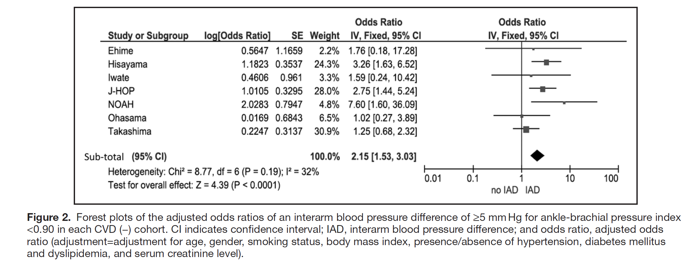
Simultaneously Measured Interarm Blood Pressure
Difference and Stroke
Tomiyama, Hl, Ohkuma, T., Ninomiya, T. et al. (2018). Simultaneously measured interarm blood pressure difference and stroke. Hypertension June 2018; 1030-1038.

Slide 59
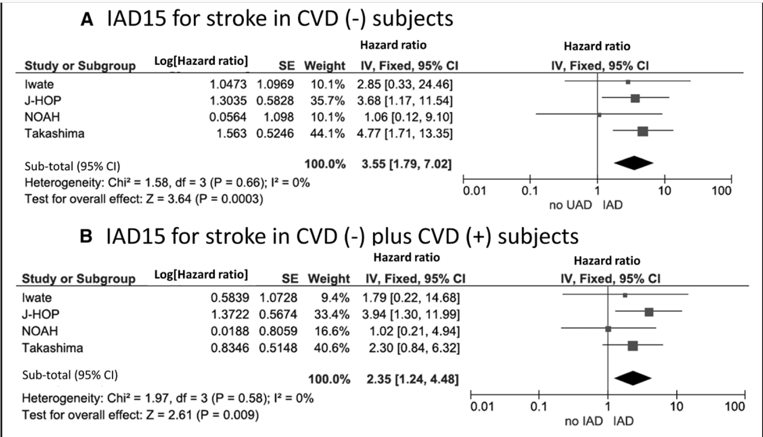
Simultaneously Measured Interarm Blood Pressure
Difference and Stroke
Tomiyama, Hl, Ohkuma, T., Ninomiya, T. et al. (2018). Simultaneously measured interarm blood pressure difference and stroke. Hypertension June 2018; 1030-1038.

Slide 60
Simultaneously Measured Interarm Blood Pressure
Difference and Stroke
BaleDoneen Take Away:
1. This was the first study to examine IAD SBP > 15mm/Hg showing significant association with ABI < 0.9 in patients with and without CVD.
2. Not everyone has access to ABI in their clinics however everyone could do this – protocol used supine simultaneous BP readings (could be a limitation).
3. Love the cost- effective approach of this study!
4. If don’t have access to do ABI’s – this is a great opportunity. Always get validation but great opportunity.
5. Significance of diagnosing PAD is significant – Post CHARISMA Data
Tomiyama, Hl, Ohkuma, T., Ninomiya, T. et al. (2018). Simultaneously measured interarm blood pressure difference and stroke. Hypertension June 2018; 1030-1038.

Slide 61
Nicotine
Obstruction Sleep Apnea
Endodontic Disease
Gut dysbiosis

Slide 62
CPAP and NT-ProBNP & hsTnT
Untreated OSA is associated with increased risk of CAD and HF. HsTnT and NT-ProBNP are sensitive biomarkers for myocardial injury and HF.
Patients >21 years old with AHI >25/h were recruited.
Exclusion criteria: previous CPAP, any significant comorbidities including CAD and HF.
Patients randomized to CPAP or sham CPAP for 8 weeks in a crossover design with washout period of one month between treatments.
Blood samples taken at 8 pm, 3 am and 8 am during sleep studies at the end of the 8 week treatment period.
Chang, Y., Yee, B., Hoyos, C., et al. The effect of cCPAP on hsTnT and NT-ProBNP in patiens with OSA – randomized controlled trial. Sleep Medicine 39 (2017); 8-13.

Slide 63
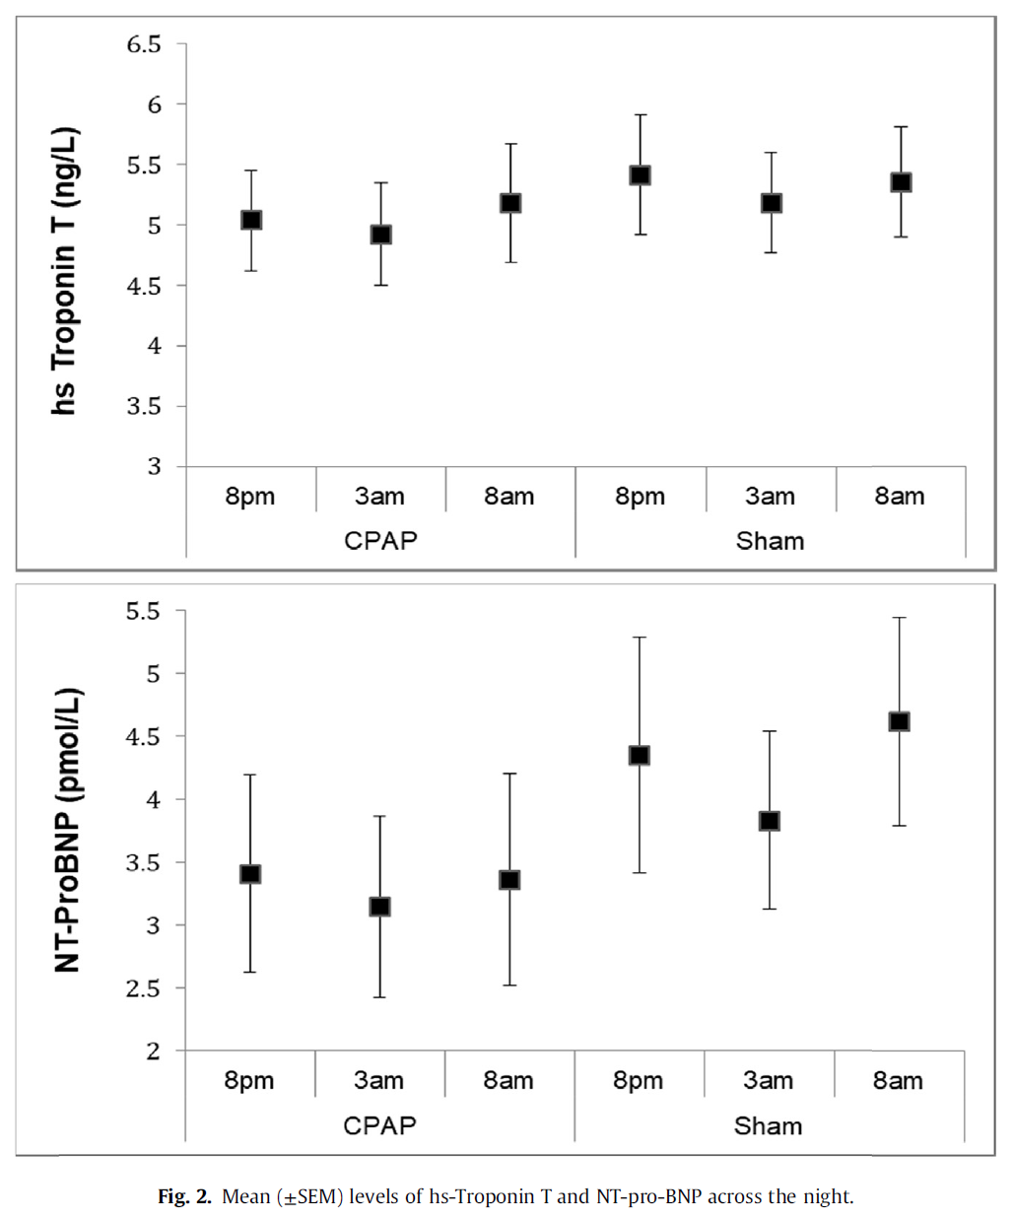
CPAP and NT-ProBNP & hsTnT
Chang, Y., Yee, B., Hoyos, C., et al. The effect of cCPAP on hsTnT and NT-ProBNP in patiens with OSA – randomized controlled trial. Sleep Medicine 39 (2017); 8-13.

Slide 64
CPAP and NT-ProBNP & hsTnT
Of the 37 patients who were randomized, 28 patients had stored frozen samples available for comparison.
CPAP significantly lowered the NT-ProBNP level by 0.91pmol/L (p=0.0002).
CPAP reduced hsTnT by 0.235 ng/L (p=0.052)
In patiens with moderate-severe OSA, CPAP reduces NT-ProBNP but doesn’t meet significance for hsTnT.
Chang, Y., Yee, B., Hoyos, C., et al. The effect of cCPAP on hsTnT and NT-ProBNP in patiens with OSA – randomized controlled trial. Sleep Medicine 39 (2017); 8-13.

Slide 65
CPAP and NT-ProBNP & hsTnT
BaleDoneen Take-Away:
1. NT-ProBNP – data to support overall heart health: Heart Happy Test, CVA, MI, Brain Atrophy, Women, and HF (new study discussed during this update session)
Chang, Y., Yee, B., Hoyos, C., et al. The effect of cCPAP on hsTnT and NT-ProBNP in patiens with OSA – randomized controlled trial. Sleep Medicine 39 (2017); 8-13.

Slide 66
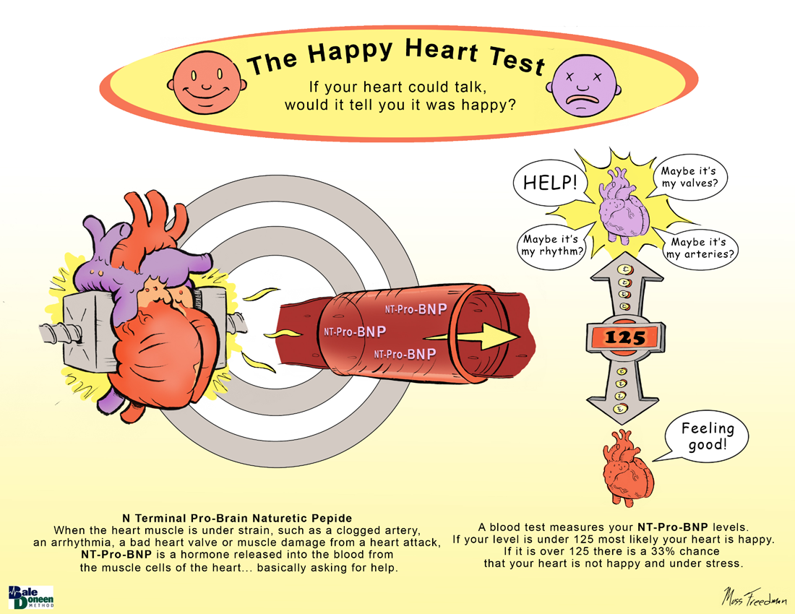

Slide 67
NT-ProBNP
Betti I, et. al., The PROBE-HF Study. J Cardiac Fail June, 2009; 15:377-384.
Melander, O., et. al. JAMA, July 1, 2009 – Vol. 302, No. 1:49-57
Cushman, M., et., al. (2014). N-Terminal Pro-B-type Natriuretic Peptide and Stroke Risk: The Reasons for Geographic and Racial Differences in Stroke Cohort. Stroke. doi: 10.1161/STROKEAHA.114.004712
Everett et al. NT-ProBNP and CVD in Women. JACC vol. 64 Nov 17, 2014. 1989-97.
Wei, J., Bakir, M., Darounian, N., et al. Myocardial scar is prevalent and associated with subclinical myocardial dysfunction in women with suspected ischemia but no obstructive coronary artery disease. Circulation. 2018;137:874-876
Behnam Sabayan et al. Arterioscler Thromb Vasc Biol. 2016;36:2246-2251

Slide 68
CPAP and NT-ProBNP & hsTnT
BaleDoneen Take-Away:
1. NT-ProBNP – data to support overall heart health (Heart Happy Test), CVA, MI, Brain Atrophy, Women
2. Measure NT-ProBNP at baseline and use it to follow your patient’s heart and brain health.
3. If it doesn’t optimize – look at the roots – including OSA!
4. Lots of opportunities – would love some of our dental colleagues who are sleep medicine docs to test this with the mouth guard in same AHI population. Help determine effectiveness of oral appliance vs CPAP in certain people rather than just a compliance issue.
Chang, Y., Yee, B., Hoyos, C., et al. The effect of cCPAP on hsTnT and NT-ProBNP in patiens with OSA – randomized controlled trial. Sleep Medicine 39 (2017); 8-13.

Slide 69
Nicotine
Endodontic Disease
Gut dysbiosis
Nicotine

Slide 70
Smoking increases risk of Ischemic stroke in young men
Historical data showed strong relationship between smoking and ischemic stroke risk in young women but paucity of data in young men.
The Stroke Prevention in Young Men Study – population-based case-control study of risk factors is ischemic stroke in men ages 15-49 years.
Study population: 615 cases and 530 case controls. First model adjusted solely for age and the second model adjusted for potential confounding factors, including age, race, education, HTN, MI, angina, DM and BMI.
OR 1.88 of ischemic stroke compared to never smokers. When current smoking group was stratified by number of cigarettes smoked, there was a dose-response relationship for OR, ranging from 1.46 (<11 cigarettes per day) to 5.66 (40+ cigarettes per day)
Markidan, J., Cole, J., Cronin, C. et al. Smoking and risk of ischemic stroke in young men. Stroke. 2018: 49;00-00.
Notes:
The Stroke Prevention in Young Men Study is a population-based case–control study of risk factors for IS in men ages 15 to 49 years. All cases were recruited within 3 years of stroke between 2003 and 2007. Controls were identified by random-digit dialing and were balanced with cases for geographic region of residence, age within 5 years, and ethnicity. Never smokers were defined as those who had not smoked >100 cigarettes or 5 packs in their lifetime. Current smokers were defined as those who had smoked >100 cigarettes in their lifetime and also had smoked in the 30 days preceding their stroke (for cases) or interview (for controls). Former smokers were defined as those who had smoked >100 cigarettes in their lifetime but had not smoked in the 30 days before their stroke/interview. Standardized interviews were conducted to collect data on smoking and other vascular risk factors.

Slide 71
Smoking increases risk of Ischemic stroke in young men
Smokers were less educated and were more likely to have hypertension, diabetes mellitus, myocardial infarction, angina, and obesity (BMI >30; all P<0.05).
Current smokers were less educated and were more likely to be black than their nonsmoking counterparts (all P<0.05).
Current smoking compared with never smokers was 1.88 (95% CI, 1.44–2.44).
There was a dose–response relationship of amount of cigarettes smoked
<11 cigarettes per day: 1.46 (95% CI, 1.04–2.06)
40+ cigarettes/d: 5.66 (95% CI, 2.14–14.95)
Markidan, J., Cole, J., Cronin, C. et al. Smoking and risk of ischemic stroke in young men. Stroke. 2018: 49;00-00.

Slide 72
Smoking increases risk of Ischemic stroke in young men
BaleDoneen Take-Away:
1. Smoking remains a HUGE issue in the US (CDC data 2016) - more than 15 of every 100 U.S. adults aged 18 years or older (15.5%) currently smoke. This means an estimated 37.8 million adults in the United States currently smoke cigarettes. More than 16 million Americans live with a smoking- related disease.
2. This study relates smoking to young men – which is a population rarely exposed to CVD prevention.
3. Of course the treatment goal is smoking cessation however this trial also supports that less if better. So – decreasing exposure is beneficial.
4. Smoking is a root cause that has 3 factors – time, quantity, intensity.
5. Always document the 5-A’s – Ask, Advise, Assess, Assist, Arrange
Markidan, J., Cole, J., Cronin, C. et al. Smoking and risk of ischemic stroke in young men. Stroke. 2018: 49;00-00.

Slide 73
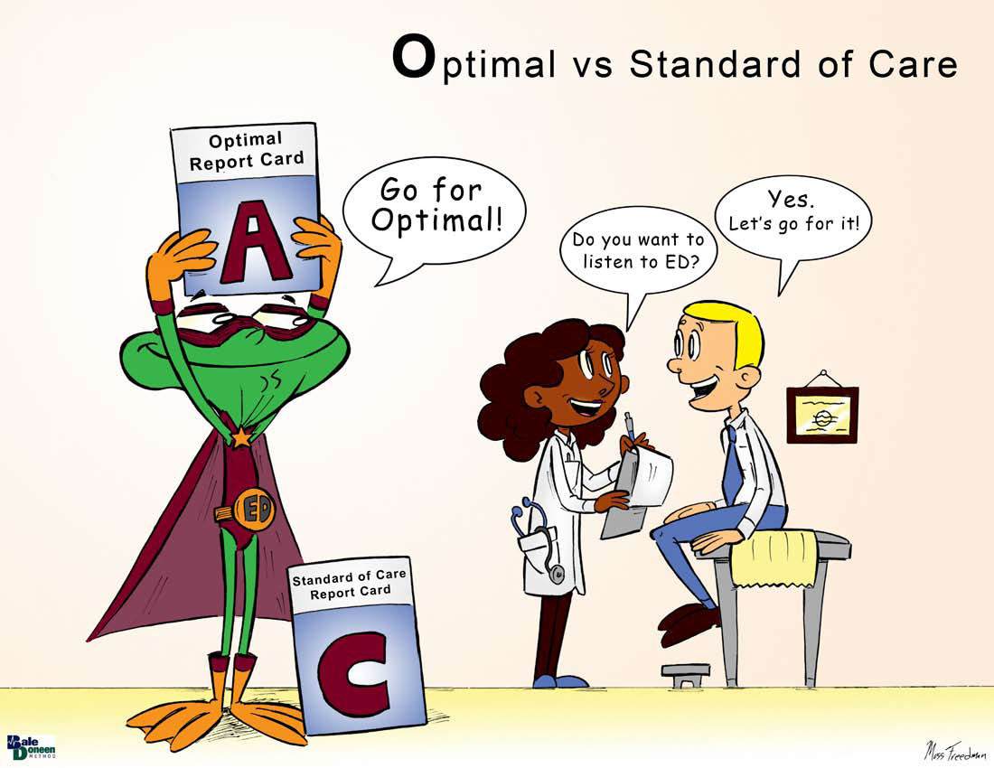

Slide 74

NT-ProBNP is predictive of mortality

Slide 75
BNP predictive of mortality in patients with and without heart failure
Natriuretic peptides (NPs) B-type NP (BNP) and N-terminal proBNP (NT-proBNP) are mainly produced by the heart in response to pressure overload and fibro-inflammation.
NPs are the current gold standard for both the diagnosis of heart failure (HF) and the follow-up of patients with HF, as recommended by international guidelines.
Repeated measurement of NPs to guide therapy of chronic HF remains debated.
Besides HF, NPs have prognostic value in patients at risk of HF
(DM, CAD, valvular disease, PE, general population)
There is no current guideline for NP measurement in these patients at risk of HF.
York, M., Gupta, D, Reynolds, C. et al. B-type natriuretic peptide levels and mortality in patients with and without heart failure. JACC;71No19, 2018.

Slide 76
BNP natriuretic peptide predictive of mortality in patients with and without heart failure
Aim of study was to compare the prognostic value of BNP between patients with and those without HF.
N=30,487 (mean age 63, 50% men, 17% black, 38% with HF) who had first plasma BNP measurement between 2002 and 2013 with f/u through 2015.
Risk of death according to BNP level was quantified.
York, M., Gupta, D, Reynolds, C. et al. B-type natriuretic peptide levels and mortality in patients with and without heart failure. JACC;71No19, 2018.
Notes:
BNP, HF, AND OTHER COVARIATES. Plasma BNP has been clinically measured at Vanderbilt University Medical Center since 2002. For patients with multiple BNP measurements, the first value was used. The Biosite Triage BNP Test (Biosite Diagnostics, San Diego, California) was the first clinical BNP assay used until February 2007. From March 2007 to September 2013, the Beckman Coulter DXI platform (Beckman Coulter, Brea, California) was used to run the Biosite BNP assay. Both platforms have coefficients of variation <12% and lower detection limits of 10 pg/ml. A patient was categorized as having HF if either of the following criteria was met: 1) 2 or more mentions of a HF ICD-9 code 428.x, where at least 1 code was recorded on the day of or before the date of first BNP measurement; and/or 2) 1 or more mentions of code 428.x and treatment with an intravenous diuretic agent on the same day or within 90 days after the BNP measurement. These criteria were designed to capture chronic and new HF diagnoses, respectively. Patients of mixed phenotype (i.e., both HF and other comorbidities that may contribute to dyspnea, such as asthma or chronic obstructive pulmonary disease, pneumonia, and sepsis) were categorized as having

Slide 77
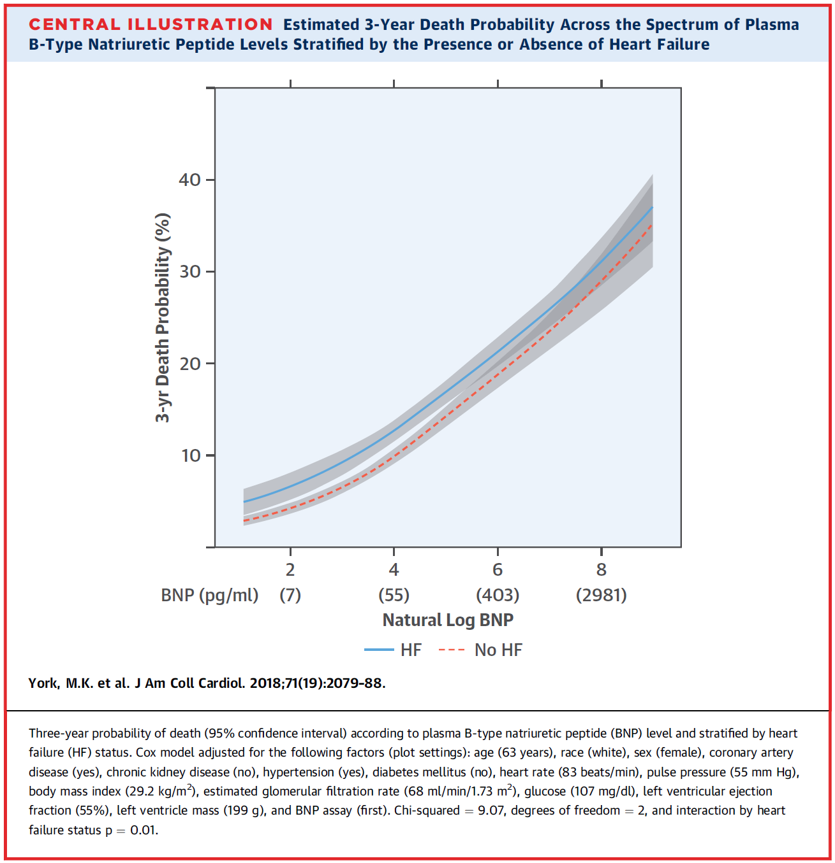
BNP natriuretic peptide predictive of mortality in patients with and without heart failure
York, M., Gupta, D, Reynolds, C. et al. B-type natriuretic peptide levels and mortality in patients with and without heart failure. JACC;71No19, 2018.

Slide 78
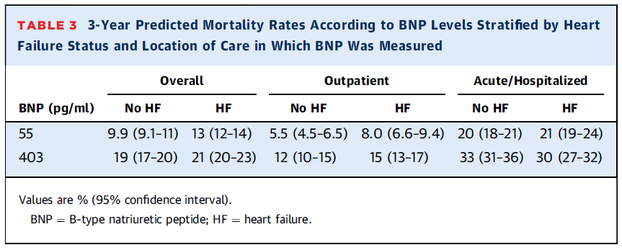
BNP natriuretic peptide predictive of mortality in patients with and without heart failure
York, M., Gupta, D, Reynolds, C. et al. B-type natriuretic peptide levels and mortality in patients with and without heart failure. JACC;71No19, 2018.

Slide 79
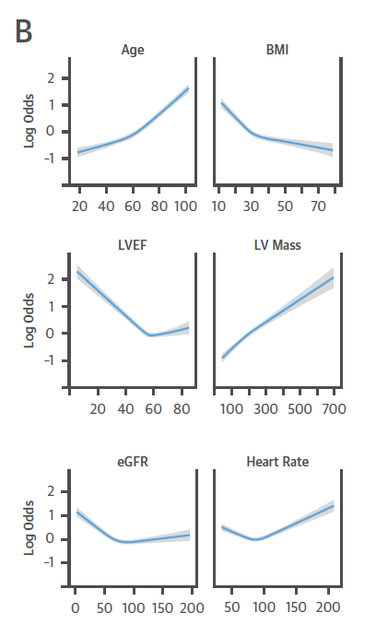
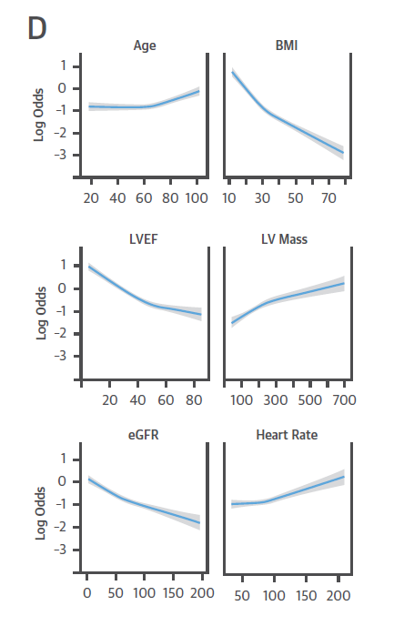
BNP natriuretic peptide predictive of mortality in patients with and without heart failure
Non heart failure
Heart failure
Inverse relationship: BMI & LVHF
Most predictive:
Age
Renal Function
LV Dysfunction
York, M., Gupta, D, Reynolds, C. et al. B-type natriuretic peptide levels and mortality in patients with and without heart failure. JACC;71No19, 2018.

Slide 80
BNP natriuretic peptide predictive of mortality in patients with and without heart failure
Summary of findings by the authors:
1. Age, BMI, renal function, LV mass, and LVEF were the factors most strongly associated with circulating BNP levels
2. Risk for death associated with any given BNP level was similar between patients with and without HF, particularly in the acute care setting
3. BNP was the strongest predictor of death among patients without HF.
York, M., Gupta, D, Reynolds, C. et al. B-type natriuretic peptide levels and mortality in patients with and without heart failure. JACC;71No19, 2018.

Slide 81
BNP natriuretic peptide predictive of mortality in patients with and without heart failure
BaleDoneen Take-Away:
1. Despite many limitations to this study, it does validate the importance of measuring natriuretic peptide levels in all patients for mortality predictability.
2. It also validates the importance of following the levels over time.
3. To further investigate the inverse relationship between BNP with BMI and LVEF – read: ‘The Obesity Paradox’ by Carl J. Lavie, MD with Kristin Loberg.
4. When levels elevated – investigate the Root Cause!
5. As discussed previously – strive for optimal (n of 1).
6. The difference between NT proBNP and BNP was not the disputed issue – it was about the elevation of natriuretic peptides over time that carried predictability.
York, M., Gupta, D, Reynolds, C. et al. B-type natriuretic peptide levels and mortality in patients with and without heart failure. JACC;71No19, 2018.

Slide 82


Slide 83


Slide 84



Slide 85
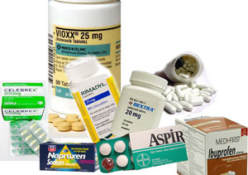
Treatment
NSAIDS

Slide 86
Aspirin and NSAIDs – a safety review
Aim of this study was to compare the safety of combining NSAIDs with low-dose aspirin. Post-hoc analysis of the Precision trial
N=23,953 patients with osteoarthritis or rheumatoid arthritis at increased CV risk randomized to celecoxib, ibuprofen, or naproxen. The on-treatment population was used for this study.
Outcomes included composite MACE, non-CV death, gastrointestinal or renal events, and components of the composites.
Reed, G., Abdallah, M., Shao, M. et al. Effect of aspirin coadministration on safety of celecoxib, naproxen, or ibuprophen. JACC.Vol 71, No16. 2018;1741-1751.

Slide 87
Aspirin and NSAIDs – a safety review
What was the PRECISION trial?
Multicenter, randomized controlled trial of patients with OA or RA on long-term NSAIDs at increased CV risk that demonstrated the noninferiority of moderate-dose celecoxib (100 to 200 mg twice daily) to naproxen (375 to 500 mg twice daily) and ibuprofen (600 to 800 mg 3 times daily).
What did this Post Hoc study evaluate?
1. ASA vs no ASA among all patients (NSAIDs pooled together)
2. ASA vs no ASA use amonth patients on celecoxib, naproxen or ibuprophen
3. celecoxib, naproxen, or ibuprofen use in patients not on aspirin
4. celecoxib, naproxen, or ibuprofen use in patients on aspirin.
Reed, G., Abdallah, M., Shao, M. et al. Effect of aspirin coadministration on safety of celecoxib, naproxen, or ibuprophen. JACC.Vol 71, No16. 2018;1741-1751.

Slide 88
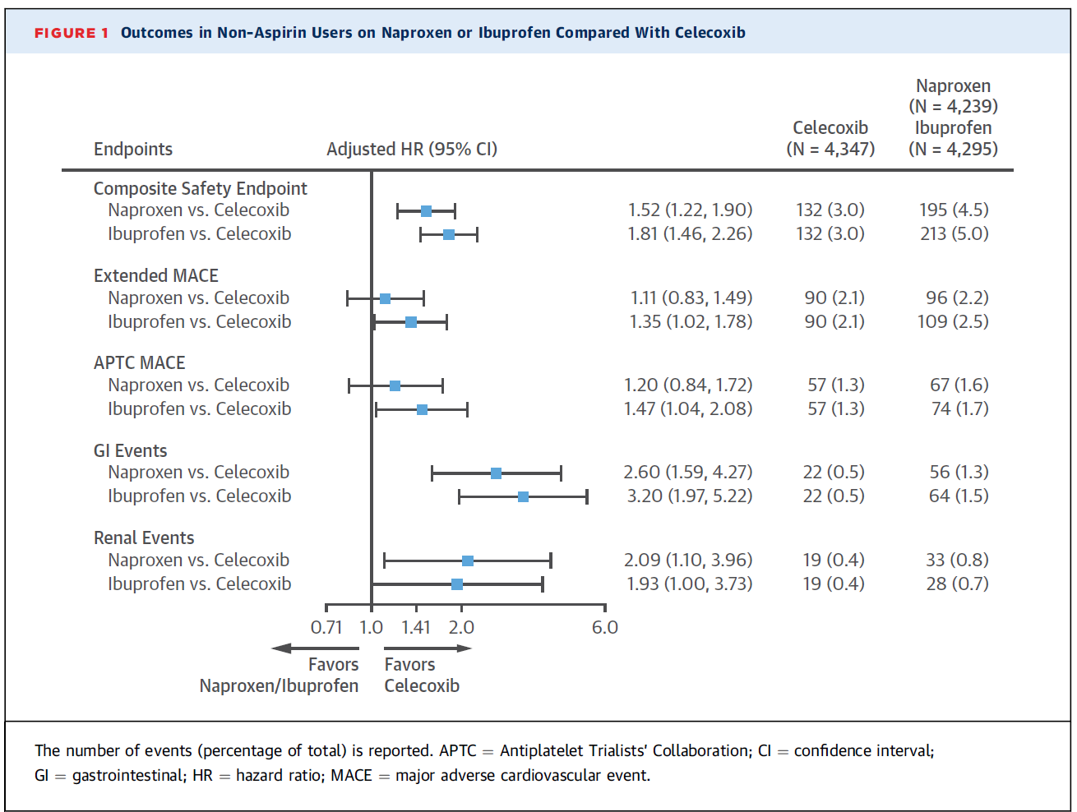
Aspirin and NSAID – a safety review
Reed, G., Abdallah, M., Shao, M. et al. Effect of aspirin coadministration on safety of celecoxib, naproxen, or ibuprophen. JACC.Vol 71, No16. 2018;1741-1751.

Slide 89
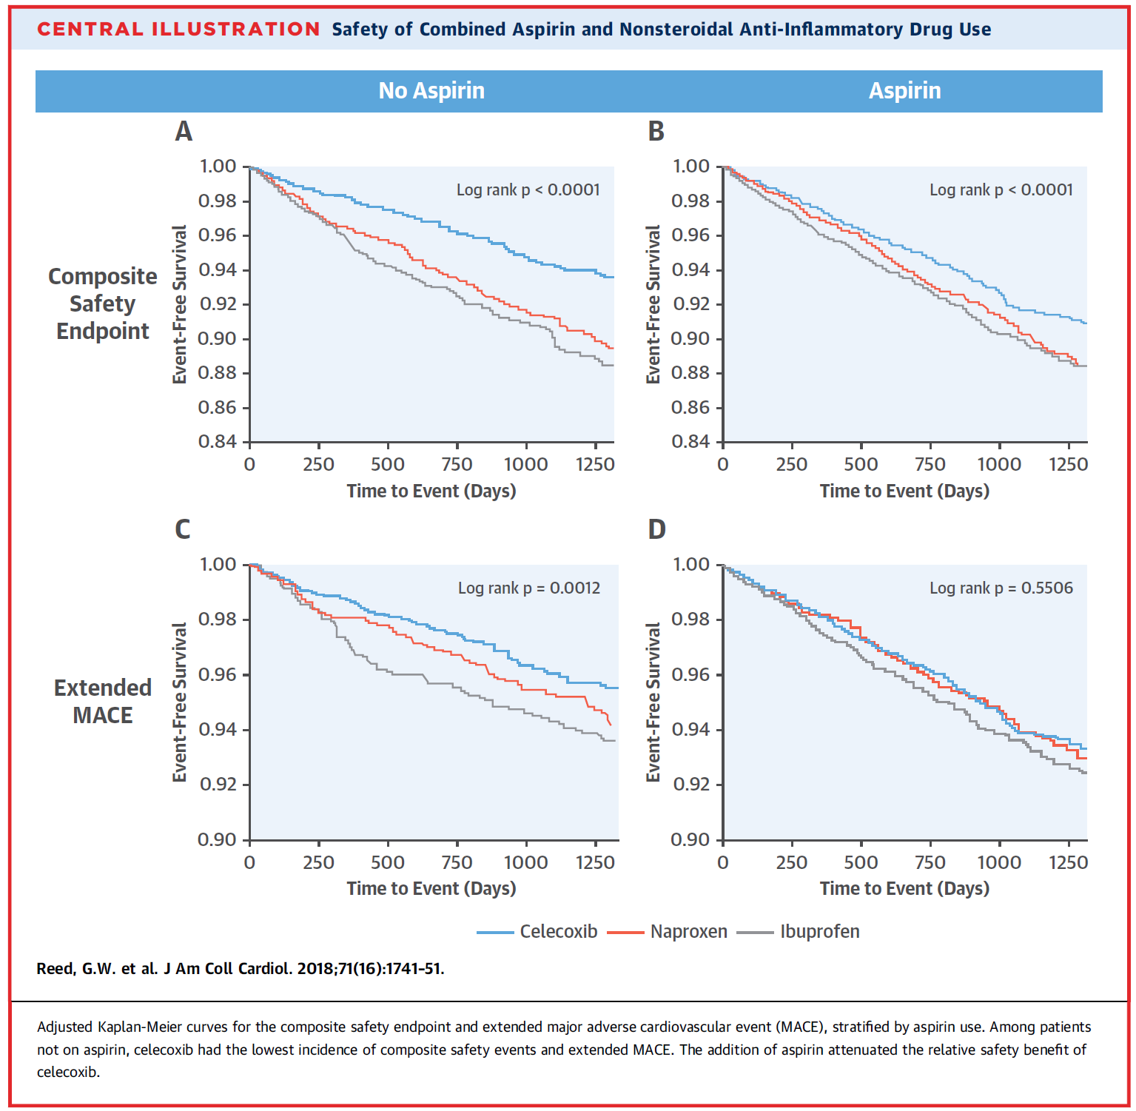
Aspirin and NSAID – a safety review
Composite safety
and MACE
Reed, G., Abdallah, M., Shao, M. et al. Effect of aspirin coadministration on safety of celecoxib, naproxen, or ibuprophen. JACC.Vol 71, No16. 2018;1741-1751.

Slide 90
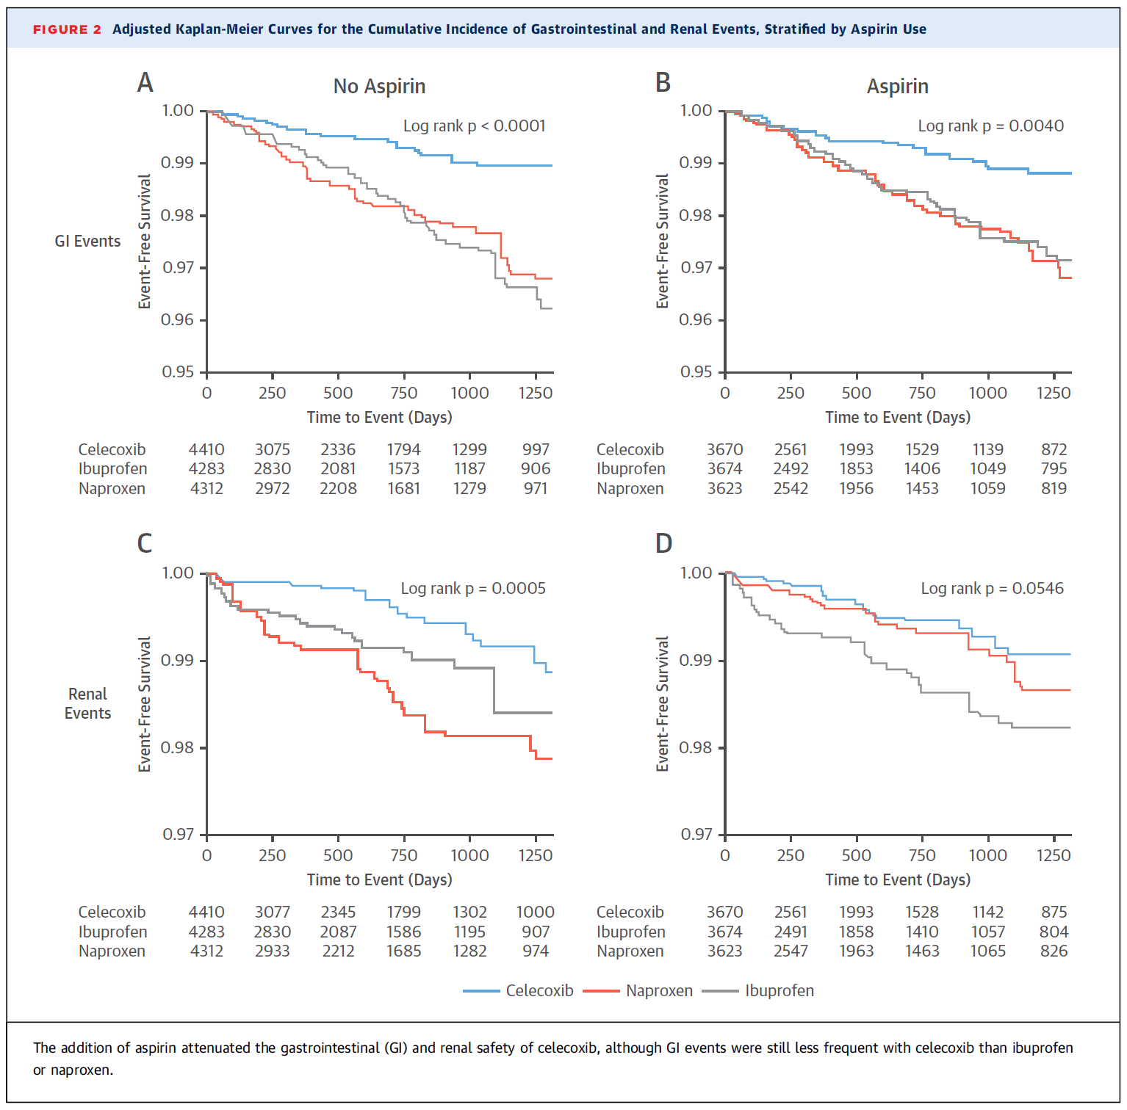
Aspirin and NSAID – a safety review
GI and Renal
Reed, G., Abdallah, M., Shao, M. et al. Effect of aspirin coadministration on safety of celecoxib, naproxen, or ibuprophen. JACC.Vol 71, No16. 2018;1741-1751.

Slide 91
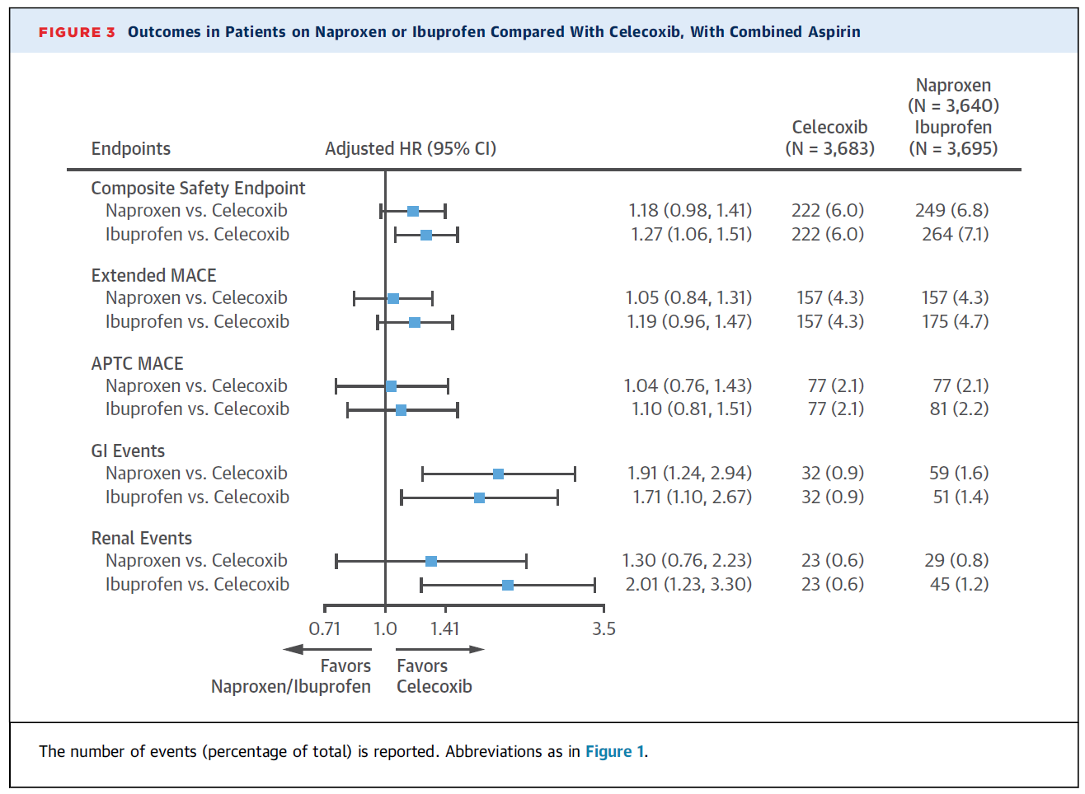
Aspirin and NSAID – a safety review
Reed, G., Abdallah, M., Shao, M. et al. Effect of aspirin coadministration on safety of celecoxib, naproxen, or ibuprophen. JACC.Vol 71, No16. 2018;1741-1751.

Slide 92
Aspirin and NSAID – a safety review
Study findings:
Among patients not taking aspirin, moderate-dose celecoxib is associated with a more favorable overall safety profile compared with naproxen or ibuprofen.
Combination with aspirin attenuates the safety advantage of celecoxib, although celecoxib is still associated with fewer GI events than ibuprofen or naproxen and fewer renal events than ibuprofen.
These results suggest that in many cases, celecoxib would be preferred to naproxen or ibuprofen, especially if the patient is not required to take aspirin.
Reed, G., Abdallah, M., Shao, M. et al. Effect of aspirin coadministration on safety of celecoxib, naproxen, or ibuprophen. JACC.Vol 71, No16. 2018;1741-1751.

Slide 93
Aspirin and NSAID – a safety review
BaleDoneen Take-Away:
1. Previous data of CAD and CVA safety suggests using NSAID with lowest COX-2 Selectivity. This data supports previous findings.
2. NSAIDS should never be considered a benign drug, despite all but Celebrex OTC. Part of the issue is the long-term application of these drugs.
3. To determine safety – examine the n of 1. AHA supports non-medical management of muscle/skeletal pain – PT, ice/heat, accupunture, message, etc prior to using ANY NSAID, including Celebrex.
4. Monitor your patients closely – renal function, GI and CV risk.
5. Establish good relationships with anxillary care providers to support your patient’s OA and RA symptoms.
Reed, G., Abdallah, M., Shao, M. et al. Effect of aspirin coadministration on safety of celecoxib, naproxen, or ibuprophen. JACC.Vol 71, No16. 2018;1741-1751.

Slide 94

Treatment
Supplements

Slide 95
Supplemental Vitamins and Minerals for CVD Prevention and Treatment
The authors identified individual randomized controlled trials from previous meta-analyses and additional searches, and then performed meta-analyses on CVD outcomes and all-cause mortality.
Assessed publications from 2012, both before and including the USPSTF review.
1. Moderate- or low-quality evidence for preventive benefits (folic acid, B-vitamins)
2. No effect (MVI, vitamins C, D, b-carotene, calcium, and selenium)
3. Increased risk (antioxidant mixtures and niacin/statin)
Conclusive evidence for the benefit of any supplement across all dietary backgrounds (including deficiency and sufficiency) was not demonstrated; therefore, any benefits seen must be balanced against possible risks.
Jenkins, D., Spence, D., Giovannucci, E. et al. Supplemental vitamins and minerals for CVD prevention and treatment. JACC.Vol 71(22) 2018; 2570-84)

Slide 96
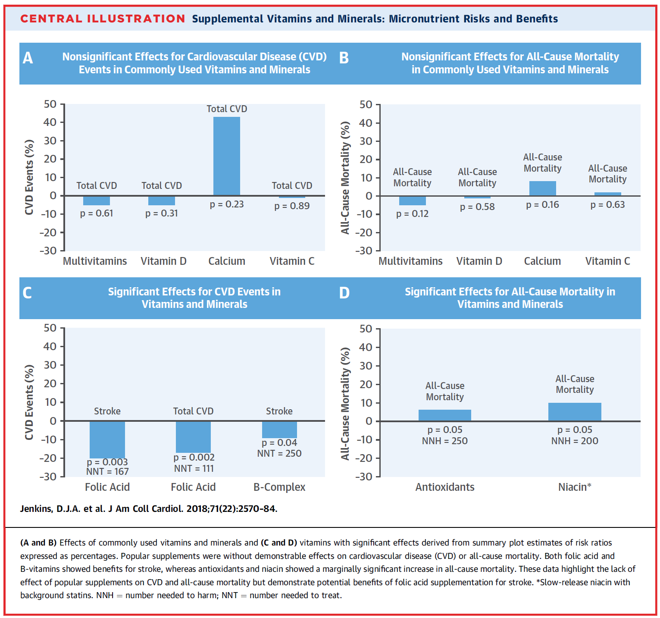
Supplemental Vitamins and Minerals for CVD Prevention and Treatment
Jenkins, D., Spence, D., Giovannucci, E. et al. Supplemental vitamins and minerals for CVD prevention and treatment. JACC.Vol 71(22) 2018; 2570-84)

Slide 97
Supplemental Vitamins and Minerals for CVD Prevention and Treatment
Let’s examine the statements made about Vitamin D and Vitamin B3 which are two of our most commonly prescribed supplements for CVD reasons.
Jenkins, D., Spence, D., Giovannucci, E. et al. Supplemental vitamins and minerals for CVD prevention and treatment. JACC.Vol 71(22) 2018; 2570-84)

Slide 98
Let’s see what they say about Vitamin D?

Slide 99
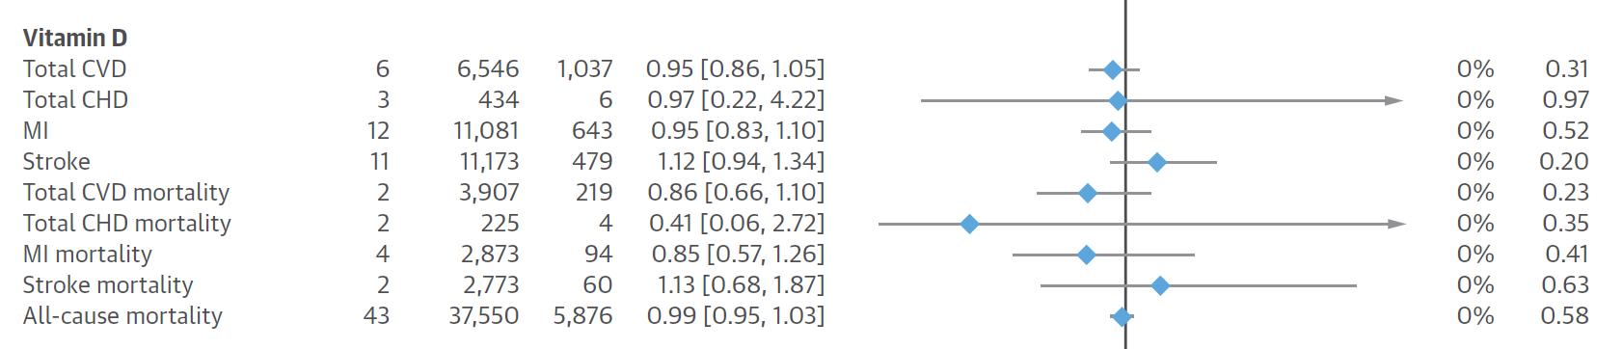
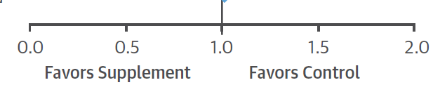
Supplemental Vitamins and Minerals for CVD Prevention and Treatment
Vitamin D
Jenkins, D., Spence, D., Giovannucci, E. et al. Supplemental vitamins and minerals for CVD prevention and treatment. JACC.Vol 71(22) 2018; 2570-84)

Slide 100

Vit D

Slide 101
Major Risk Factors for Vit. D Deficiency
Aging
Increased distance from the equator
Winter seasons
Darkly pigmented skin
Institutionalized/
housebound
Sunscreens and cover-up clothing
Air pollution
Smoking
Obesity
Physical inactivity
Genetic factors
Malabsorption
Renal disease
Liver disease
Certain medications
Glucocorticoids
Antirejection medications
Human immunodeficiency virus medications
Certain antiepileptic drugs
Lavie, C. J., et. al. J. Am. Coll. Cardiol. 10/4/2011;58;1547-1556

Slide 102
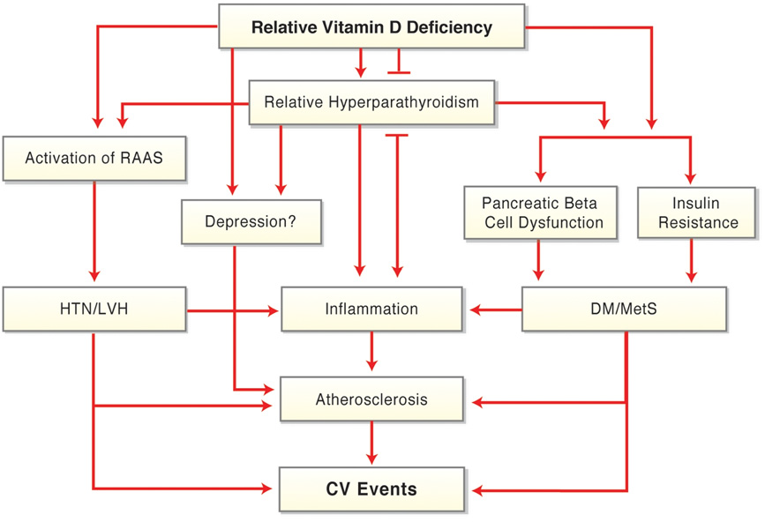
Potential Mechanisms for CV Effects of Vitamin D Deficiency
Lavie, C. J., et. al. J. Am. Coll. Cardiol. 10/4/2011;58;1547-1556

Slide 103
Vitamin D Deficiency
Cardiovascular Disorders and T2 DM
Vitamin D deficiency found to be related to:
1. Coronary artery disease
2. Influence the activity/expression of macropages and lymphocytoctes in atherosclerotic plaques – promoting chronic inflammation in the artery wall
3. Increase in vascular endothelial growth factor expression and pro-matrix MMP-2
4. Elevation in PTH levels, which have been linked to IR and increases in acute phase proteins.
Hossein-nezhad, A., et al. Vitamin D for health. Mayoclinicproceedings. July 2013. 88(7):720-753

Slide 104
Two new studies this week regarding Vitamin D

Slide 105
Vitamin D concentration and risk of T2DM and PreDM
Cohort study of 903 adults who were known to be free of diabetes or prediabetes during a 1997±1999 visit to a NIH Lipid Research Centers clinic. Plasma 25(OH)D was measured at Visit 8 in 1977±1979.
The mean age was 74 years. The visit also included fasting plasma glucose and oral glucose tolerance testing. Follow-up continued through 2009.
There was an inverse dose-response gradient between 25(OH)D concentration and risk of diabetes with a p for trend of 0.005. Each 10 ng/mL or 25 nmol/L higher 25(OH)D concentration was associated with a HR of 0.64, CI = 0.48±0.86.
Park, S., Garland, C., Gorham, E. et al. Plasma 25-hydroxyvitaminD concentration and risk of type 2 diabetes and pre-diabetes: 12 year cohort study. PLOS One. 2018, 1-17.

Slide 106
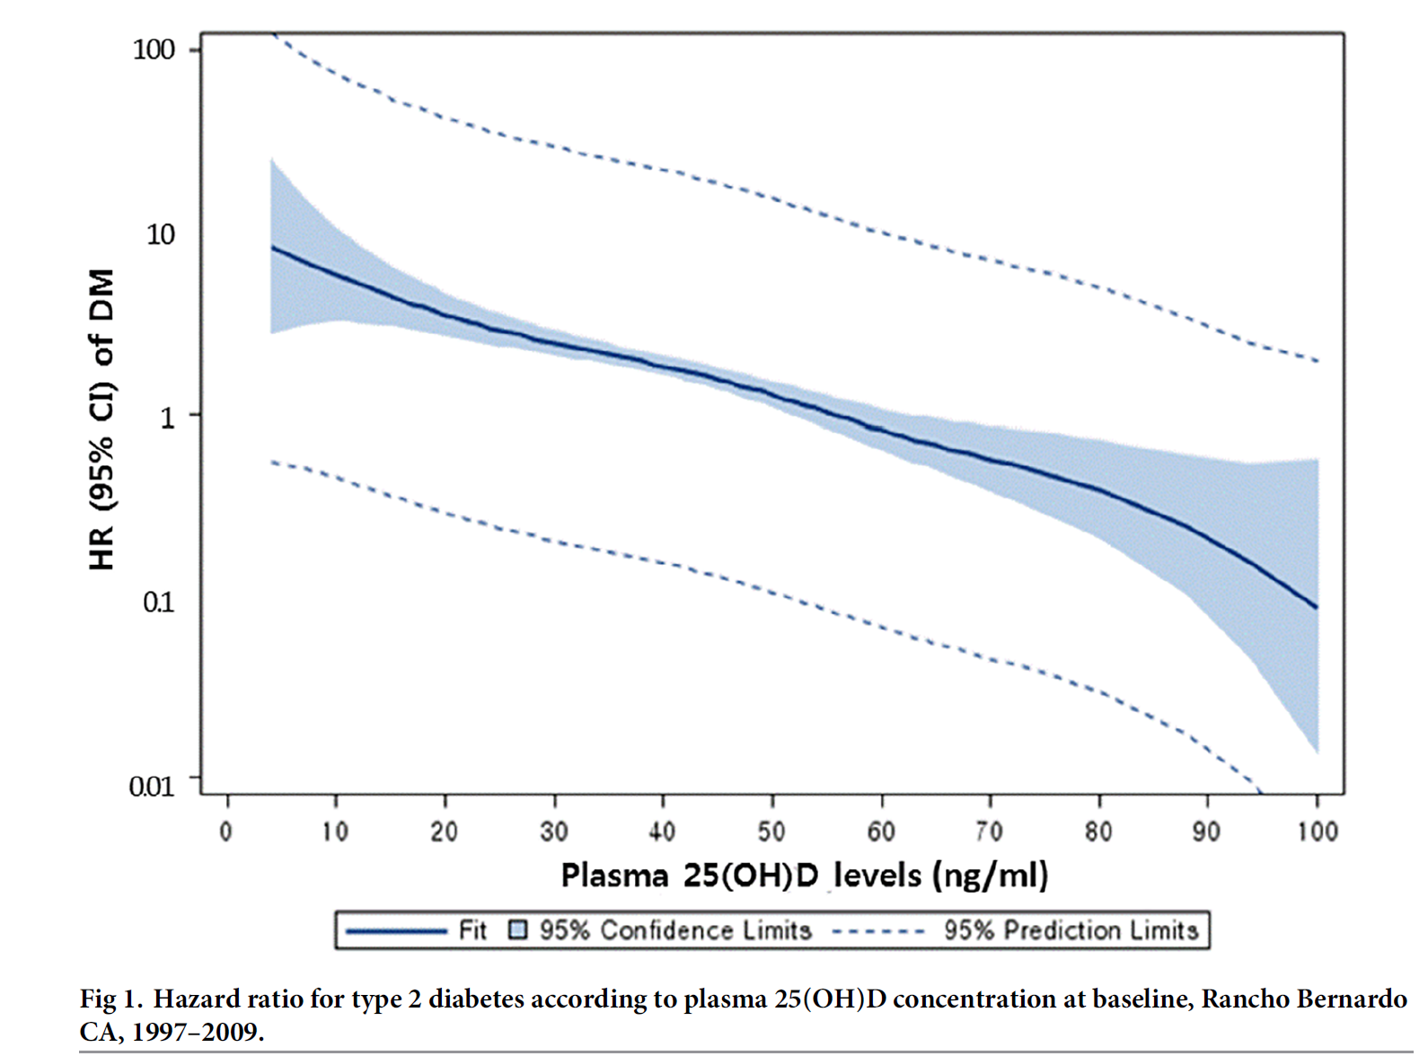
Vitamin D concentration and risk of T2DM and PreDM
Park, S., Garland, C., Gorham, E. et al. Plasma 25-hydroxyvitaminD concentration and risk of type 2 diabetes and pre-diabetes: 12 year cohort study. PLOS One. 2018, 1-17.

Slide 107
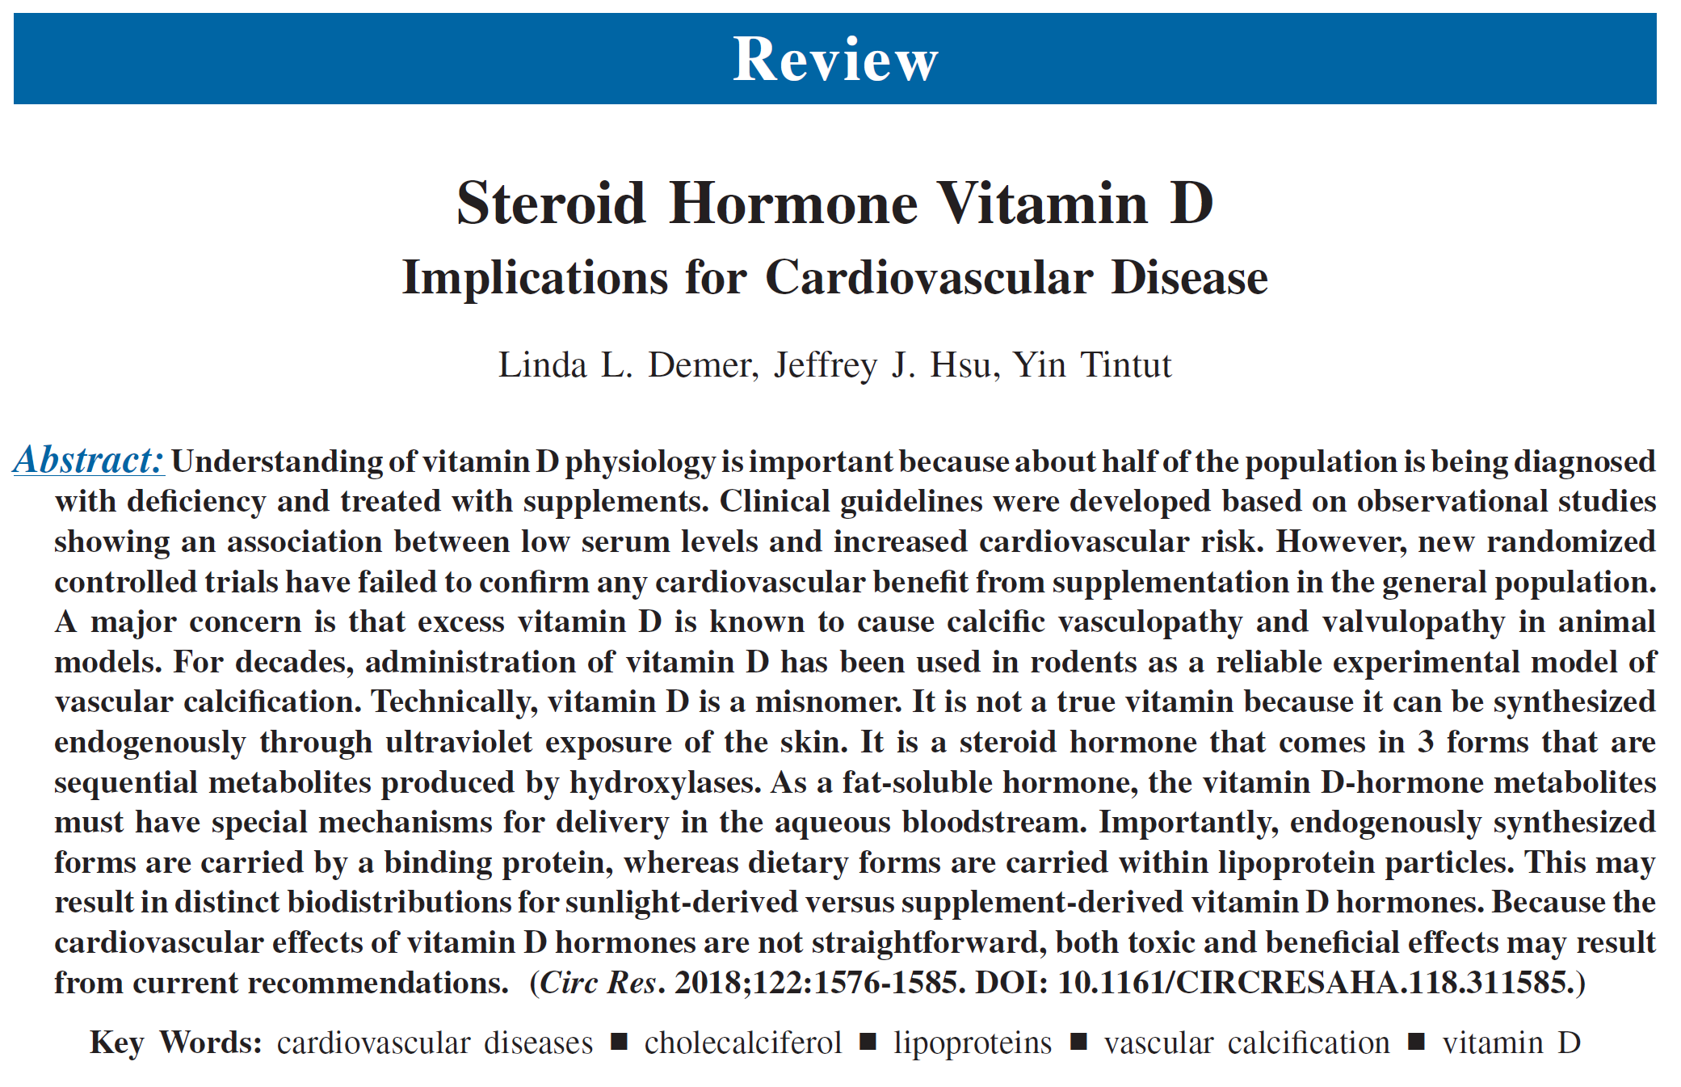
New data comes in weekly –Publication this week in response to the JACC article
Technically, vitamin D is a misnomer. It is not a true vitamin because it can be synthesized endogenously through ultraviolet exposure of the skin. It is a steroid hormone that comes in 3 forms that are sequential metabolites produced by hydroxylases. As a fat-soluble hormone, the vitamin D-hormone metabolites
must have special mechanisms for delivery in the aqueous bloodstream. Importantly, endogenously synthesized forms are carried by a binding protein, whereas dietary forms are carried within lipoprotein particles. This may result in distinct biodistributions for sunlight-derived versus supplement-derived vitamin D hormones. Because the cardiovascular effects of vitamin D hormones are not straightforward, both toxic and beneficial effects may result from current recommendations.

Slide 108
Going back to the JACC article
Let’s see what they say about Vitamin B3?

Slide 109
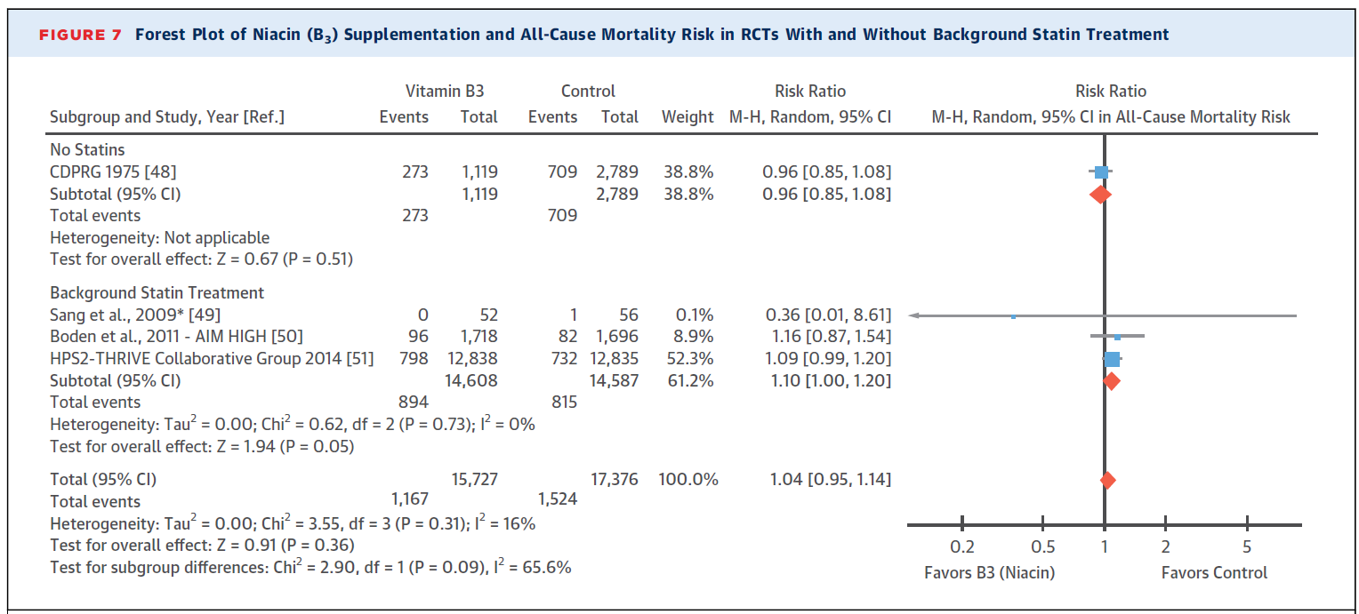
Supplemental Vitamins and Minerals for CVD Prevention and Treatment
Jenkins, D., Spence, D., Giovannucci, E. et al. Supplemental vitamins and minerals for CVD prevention and treatment. JACC.Vol 71(22) 2018; 2570-84)

Slide 110
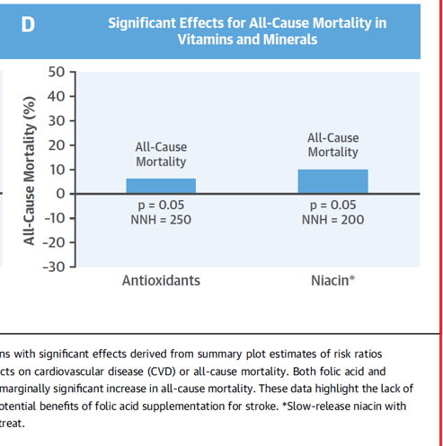
Supplemental Vitamins and Minerals for CVD Prevention and Treatment
This is slow-release niacin
Jenkins, D., Spence, D., Giovannucci, E. et al. Supplemental vitamins and minerals for CVD prevention and treatment. JACC.Vol 71(22) 2018; 2570-84)

Slide 111
Niacin Metabolism
#1 conjugation with glycine
#2 non-conjugation
O
COH
Pathway 1
(Flushing)
N
Pathway 2
(Hepatotoxicity)
NUA
NAM
NUA = nicotinuric acid
NAM = nicotinamide
6HN = 6-hydroxy nicotinamide
NNO = nicotinamide-N-oxide
MNA = N-methylnicotinamide
NAD = nicotinamide adenine dinucleotide
2PY = N-methyl-2-pyridone-5-carboxamide
4PY = N-methyl-4-pyridone-5-carboxamide
6HN
NNO
MNA
NAD
2PY 4PY
Notes:
Niacin Metabolism
Niacin is metabolized along two pathways: conjugation with glycine to form nicotinuric acid (NUA) (pathway1), which may contribute to the flushing; and non-conjugative metabolism (pathway 2) leading to nicotinamide adenine dinucleotide (NAD) and potentially to hepatotoxicity. The absorption rate of Niaspan is controlled to minimize the accumulation of metabolites from pathway 1 and pathway 2 and, therefore, decreases the incidence of adverse effects associated with these pathways.

Slide 112
Other CV benefits of niacin
Increases PDG2 which leads to 15-deoxyprostaglandin J2 which is potent ligand of PPAR-gamma
Stimulates the receptor G-protein (GPR109A) which is found on immune cells and may explain some of niacin’s anti-inflammatory effects
Decreases fibrinogen
Increases adiponectin
Reduces ADMA
Journal of Clinical Lipidology 8/2007 Vol 1, No. 4:248-255

Slide 113
Niacin promotes reverse cholesterol transport
Niacin can stimulate ABCA1 mediated cholesterol efflux from macrophages *
Niacin facilitates SR-B1 cholesterol efflux from macrophages **
*Rubic T, Biochem Pharmacol. 2004;67:411-419
**John M. Morgan, et. Al., Journal of Clinical Lipidology 12/2007, Vol 1, No 6:614-619
Notes:
Adenosine triphosphate-binding cassette transporter A1 (ABCA1) and scavenger receptor class B type 1 (SR-B1) both promote efflux of cholesterol from macrophages in the intima to HDL and ApoA1 particles for transport to the liver – reverse cholesterol transport (RCT) which should be a necessary step to achieve regression. Niacin has been shown to enhance both of these transport mechanisms.

Slide 114
Supplemental Vitamins and Minerals for CVD Prevention and Treatment
Largest study in this meta-analysis was HPS2Thrive and next AIM HIGH
Not included:
HATS
Arbiter
Lipo(a)
DPP
Jenkins, D., Spence, D., Giovannucci, E. et al. Supplemental vitamins and minerals for CVD prevention and treatment. JACC.Vol 71(22) 2018; 2570-84)

Slide 115


Slide 117
May 26, 2011: AIM HIGH
NHLBI announced that the AIM-HIGH study has been stopped. All AIM-HIGH participants were treated with simvastatin, with the possible addition of ezetimibe, to achieve an LDL-C between 40 and 80 mg/dL. Patients were randomly assigned to also receive either Niaspan or placebo.
The AIM-HIGH data and safety monitoring board recommended stopping the trial as of May 25, 2011 because of lack of efficacy.
the trial does not show a significant difference in cardiovascular outcome event rates between the two study arms.
Notes:
There were a total of 28 ischemic strokes (1.6%) in the Niaspan plus simvastatin arm and a total of 12 such events (0.7%) reported in the simvastatin arm.

Slide 118
Bale/Doneen Method Thoughts:
AIM-HIGH was slated to validate many of our observations of previous clinical trials and certain clinical observations.
The NHLBI’s decision to halt this trial is based on a lack of efficacy, not an increase risk for clinical events.

Slide 119
Intent to treat
Intent to treat: AIM HIGH was designed as an “intent to treat” study.
9 of ischemic stroke events reported in the niaspan arm occurred after the subjects had stopped taking Niaspan for 67-1467 days.
Niaspan administration requires careful monitoring to insure compliance with treatment.

Slide 120
Confounding Therapies:
Confounding therapies: Ezetimibe was used in 515 participants as an add-on therapy to the statin therapy with the intent to get LDL to the treated goal of 40-80. It remains yet unclear how many participants in the Niacin/statin ischemic stroke arm were also taking ezetimibe.
The potential interaction between Niaspan and ezetimibe has never been formally evaluated.

Slide 121
Population:
Population: Inclusion criteria for the study subjects included established cardiovascular disease and atherogenic dyslipidemia.
This demographic possesses a multi-factorial treatment challenge, often including obesity, hypertension, insulin resistance and metabolic syndrome.
This study was designed to treat only the lipid portion of this risk factor profile.

Slide 122

Supplemental Vitamins and Minerals for CVD Prevention and Treatment
Jenkins, D., Spence, D., Giovannucci, E. et al. Supplemental vitamins and minerals for CVD prevention and treatment. JACC.Vol 71(22) 2018; 2570-84)

Slide 123
For the BaleDoneen Take-Away on this JACC analysis – I chose to let an expert speak on our behalf -
Dr. Robert Bailey, MD (BaleDoneen community member, friend, colleague, mentor)
1. Doctor of Pharmacy (PharmD) at the Medical University of South Carolina in Charleston, SC.
2. MD degree Creighton U and Family Medicine Residency Hillcrest Hospital Tulsa, OK.
3. Finished a two year post PharmD Residency in Clinical Pharmacy and Critical Care Nutrition (TPN and Enteral feeding)
4. At Creighton U. School of Medicine and taught elective course on Total Parenteral Nutrition (TPN) to pharmacy and medical students
5.Clinical TPN expert at St. Joseph Hospital and Bergan Mercy Hospital in Omaha, NE and also taught the medical students at Creighton an orientation to clinical research.
6. At Mayo Clinic Scottsdale I conducted a IRB approved clinical trial on Red Yeast Rice in hypercholesterolemia.
7. I received the educational grant 2 years running along with two neurologists to educate the medical trainees and faculty on Evidence-Based Research Methodology.
8. Served on the Mayo Clinic Research Committee which reviewed all clinical studies at Mayo Scottsdale during my 3 year tenure.
9. Attended numerous conferences over the years on nutraceuticals including the well know Scripts Annual Symposium on Evidence-Based Nutritional Supplements and have incorporated the measurement and prescribing to my patients on a daily basis.

Slide 124

Supplemental Vitamins and Minerals for CVD Prevention and Treatment
Dr. Robert Bailey MD, PharmD
“A paper such as this is a “headline grabber” for the news organizations, general public and those in the medical community that put no value on nutritional supplementation.”
“This paper does not represent a fair evaluation of nutraceuticals but rather to emphasize many null findings from RCTs of nutritional and vitamin supplementation dressed up into meta-analysis and evidence based statistics with no consideration of the methodologic flaws in these papers.”
“Nutraceuticals more similar to foods and are utilized to replace when found to be deficient and in certain conditions and to help restore more normal or favorable physiology.”
Jenkins, D., Spence, D., Giovannucci, E. et al. Supplemental vitamins and minerals for CVD prevention and treatment. JACC.Vol 71(22) 2018; 2570-84)

Slide 125

Make sure and get signed up for the upcoming BaleDoneen Events!
www.BaleDoneen.com
Carol@baledoneen.com

Slide 126



I have a secret – I taped this update session yesterday (Tuesday) and I am leaving the questions to the famous Dr. Bradley Bale!
Our daughter and I are currently driving the 1300 miles to her new home in San Diego

